Slide 1
Chapter 6
Computer Networks

Slide 2
Objectives
After studying this chapter, the student should be able to:
Describe network criteria, physical structures, and categories of networks.
Distinguish an internet from the internet.
Describe the TCP/IP protocol suite as the network model in the internet.
Define the layers in the TCP/IP protocol suite and their relationship.
Discuss the client-server architecture of the internet.
Describe the three early applications of the internet: electronic mail, file transfer and remote login.
Understand the world wide web as the most common application of the internet and its components.
Distinguish between the three internet document types: static, dynamic and active.
List other internet applications, such as videoconferencing, group discussions and chats.

Slide 3
INTRODUCTION
A network is a combination of hardware and software that sends data from one location to another. The hardware consists of the physical equipment that carries
signals from one point in the network to another. The software consists of instructions that make the services that we expect from a network possible.

Slide 4
Network criteria
A network must be able to meet a number of criteria. The most important of these are performance, reliability, and security.
Performance can be measured in many ways, including transit time and response time.
Reliability is measured by the frequency of failure, the time it takes to recover from a failure, and the network’s robustness in a catastrophe.
Network security issues include protecting data from unauthorized access, damage, and change, and implementing policies and procedures for recovery from breaches and data losses.

Slide 5
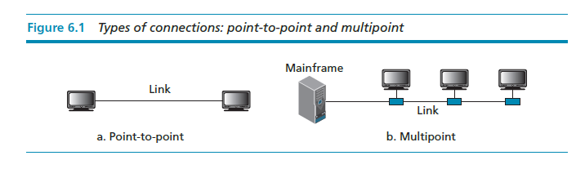
Physical structures
Before discussing networks, we need to define some network attributes.
Types of Connection: A network consists of two or more devices connected through links. A link is a communications pathway that transfers data from one device to another. There are two possible types of connections: point-to-point and multipoint.

Slide 6
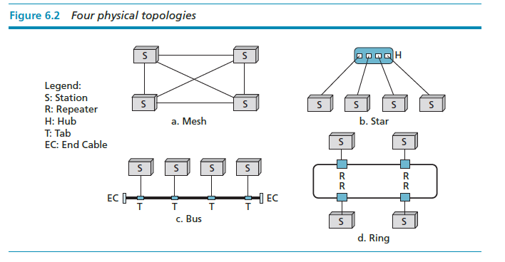
The term physical topology refers to the way in which a network is laid out physically. There are four basic topologies possible: mesh, star, bus, and ring.

Slide 7
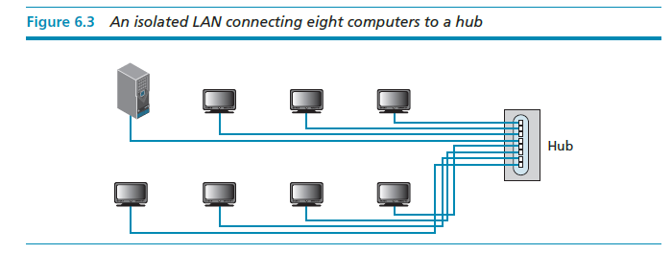
Categories of networks
Today networks can be divided into three broad categories: local-area networks (LANs), wide-area networks (WANs), and metropolitan area networks (MANs).

Slide 8
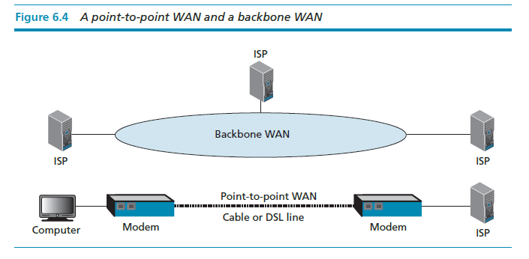

Slide 9
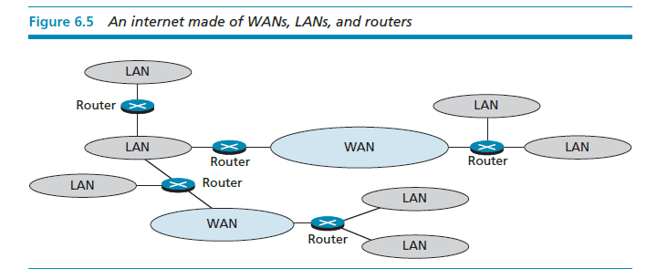
An internet
Today, it is very rare to see a network in isolation: networks are connected to one another. When two or more networks are connected, they become an internetwork, or an internet (lowercase “i”).

Slide 10
The Internet
The most notable internet is the Internet (uppercase “I”), a collaboration of hundreds of thousands of interconnected networks. Private individuals, as well as various organizations such as government agencies, schools, research facilities, corporations, and libraries in more than 100 countries use the Internet. Millions of people are users.
It is difficult to give an accurate representation of the Internet, because it is continually changing. Today most end users who want an Internet connection use the services of Internet service providers (ISPs).

Slide 11
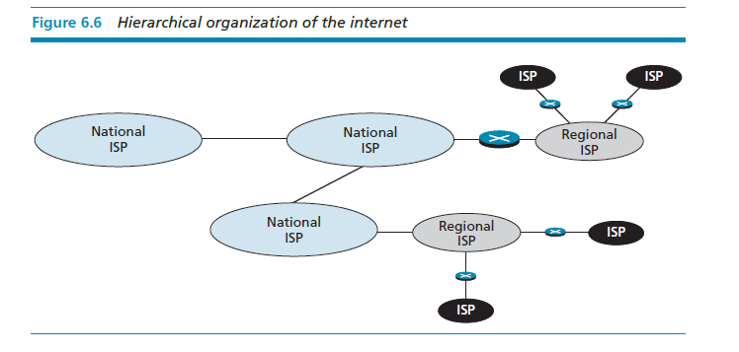

Slide 12
TCP/IP PROTOCOL SUITE
To divide the services required to perform a task, the Internet has created a set of rules called protocols. These allow different local and wide area networks, using different technologies, to be connected together and carry a message from one point to another. The set, or suite, of protocols that controls the Internet today is referred to as the TCP/IP protocol suite. The abbreviations (TCP and IP) will become clear as we explain different protocols.

Slide 13
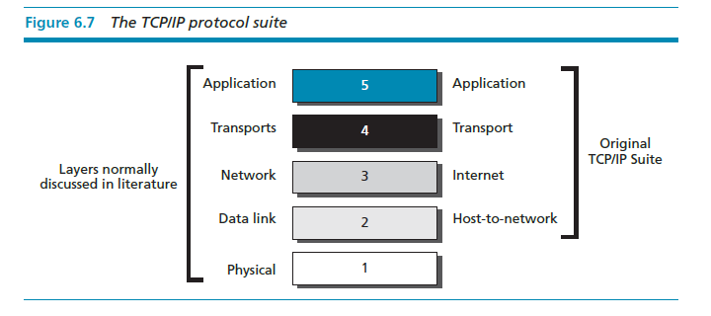
The original TCP/IP protocol suite was defined as having four layers: host-to-network (or link), internet (network), transport, and application. However, the TCP/IP protocol suite today is normally considered as a five-layer model, as shown in Figure 6.7.

Slide 14
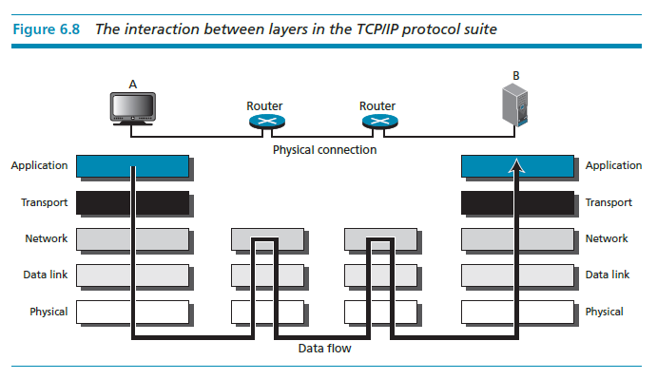
Figure 6.8 shows the layers involved when a message is sent from device A to device B. As the message travels from A to B, it may pass through many routers. Routers use only the first three layers.

Slide 15
LAYERS
This section briefly describes the function of each layer in the TCP/IP protocol suite. We show how a message travels through the different layers until it reaches the physical layer and is sent by the transmission media.

Slide 16
Application layer
The application layer enables a user, whether human or software, to access the network. It provides support for services such as electronic mail, remote file access and transfer, browsing the World Wide Web, and so on.

Slide 17
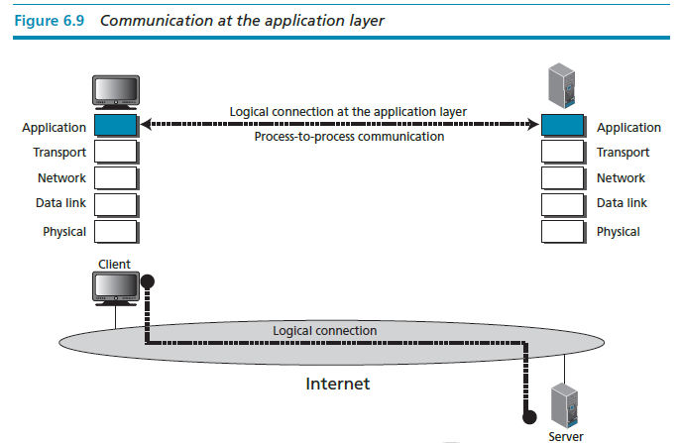
Client-server architecture
Although there are two architectures (designs) that allow two application programs, running on two remote computers, to communicate with each other, client-server architecture is more common.

Slide 18
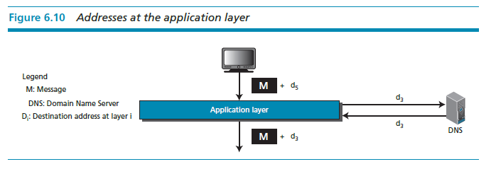
Application-layer address
When a client needs to send a request to a server, it needs the server application-layer address. For example, to identify one particular site, the client uses a Uniform Resource Locator (URL). As we will see later, the server application-layer address is not used for delivery of messages, it only helps the client to find the actual address of the server computer.

Slide 19

Transport layer
The transport layer is responsible for process-to-process delivery of the entire message: logical communication is created between the transport layer of the client and the server computer. In other words, although physical communication is between two physical layer (through many possible links and routers), the two application layers consider the transport layer as the agent that takes responsibility for delivering the messages.

Slide 20
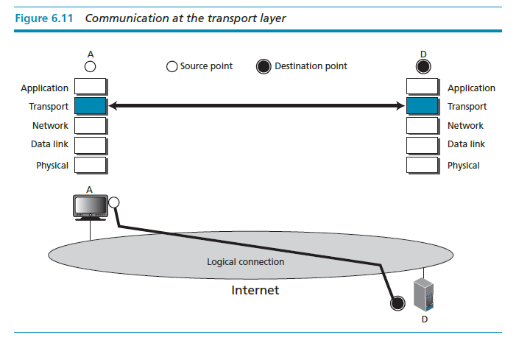

Slide 21
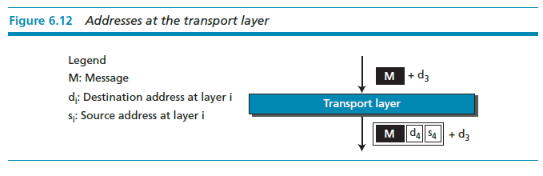
Transport-layer addresses (port numbers)
The server computer may be running several processes at the same time, for example an FTP server process and an HTTP server process. When the message arrives at the server, it must be directed to the correct process. We need another address for server process identification, called a port number.

Slide 22
Transport-layer protocols
During the life of the TCP/IP protocol suite three transport layer protocols have been designed: UDP, TCP, and SCTP.
The User Datagram Protocol (UDP) is the simplest of all three protocols. UDP does multiplexing and de-multiplexing It also does a type of error control by adding a checksum to the packet.
Transmission Control Protocol (TCP) is a protocol that supports all the duties of a transport layer. However, it is not as fast and as efficient as UDP. TCP uses sequence numbers, acknowledgment numbers, and checksums. It also uses buffers at the sender’s site. This combination of provisions provides multiplexing, de-multiplexing, flow control, congestion control, and error control.

Slide 23
Stream Control Transmission Protocol (SCTP) is a new protocol that is designed for new services expected from the Internet, such as Internet telephony and video streaming. This protocol combines the advantages of both UDP and TCP. Like UDP, it is suitable for real-time transmission of audio and video, but like TCP, it
provides error and flow control.

Slide 24
The network layer
The network layer is responsible for the source-to-destination (computer-to-computer or host-to-host) delivery of a packet, possibly across multiple networks (links). The network layer ensures that each packet gets from its point of origin to its final destination.

Slide 25
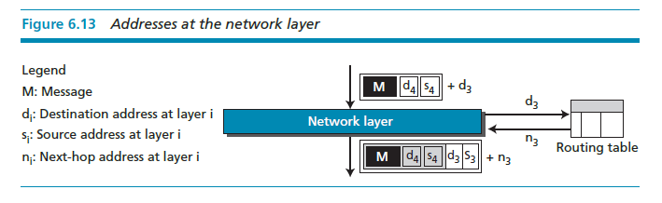
Network-layer addresses
The packet traveling from the client to the server and the packet returning from the server need network-layer address. The server address is provided by the server, as discussed above, while the client address is known by the client computer.

Slide 26
Routing
The network layer has a specific duty: routing. Routing means determination of the partial or total path of a packet. As the Internet is a collection of networks (LANs, WANs, and MANs), the delivery of a packet from its source to its destination may be a combination of several deliveries: a source-to-router delivery, several router-to-router delivery, and finally a router-to-destination delivery.

Slide 27
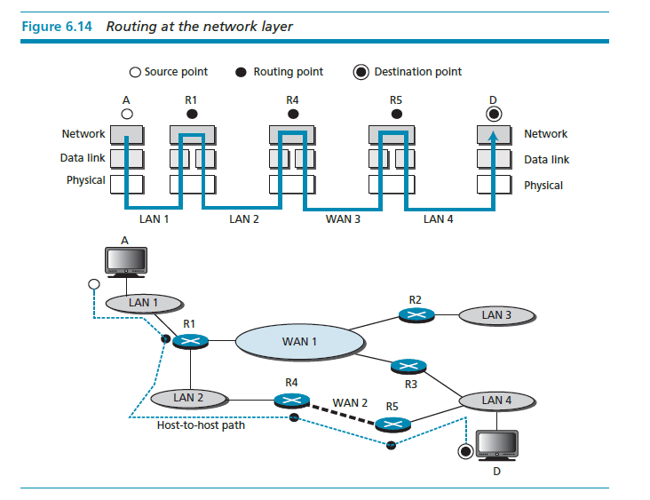

Slide 28
Network-layer protocols
The TCP/IP protocol suite supports one main protocol (IP) and several auxiliary protocols to help IP to perform its duties.
In the TCP/IP protocol suite, the main protocol at the network layer is Internet Protocol (IP). The current version is IPv4 (version 4) although IPv6 (version 6) is also in use, although not ubiquitously. IPv4 is responsible for the delivery of a packet from the source computer to the destination computer. For this purpose, every computer and router in the world is identified by a 32-bit IP address, which is presented in dotted decimal notation.

Slide 29
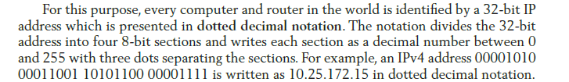

Slide 30
Data link layer
As we saw in the previous section, the network layer packet may pass through several routers in its journey from its source to its destination. Carrying the packet from one node to another (where a node can be a computer or a router) is the responsibility of the data link layer.

Slide 31
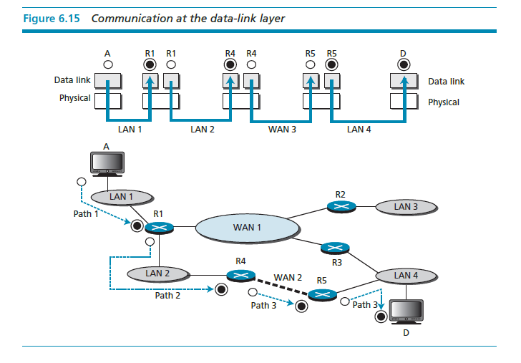

Slide 32
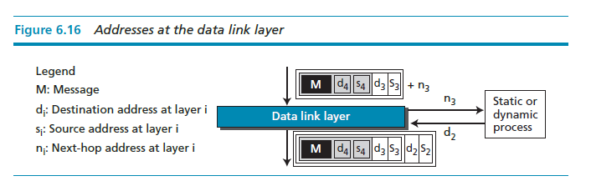
Data-link layer addresses
Two questions that come to mind are how computer A knows the data-link layer address of router R₁, or router R₁ knows the data-link layer address of router R₄. A device can find the data-link address of another device either statically or dynamically.

Slide 33
Unlike IP addresses, addresses at the data-link layer cannot be universal. Each data link protocol may have a different address format and size. The Ethernet protocol, the most prevalent local area network in use today, uses a 48-bit address, which is normally written in hexadecimal format (grouped in six sections, each with two hexadecimal digits) as shown below:

Slide 34
Physical layer
The physical layer coordinates the functions required to carry a bit stream over a physical medium. Although the data link layer is responsible for moving a frame from one node to another, the physical layer is responsible for moving the individual bits that make up the frame to the next node. In other words, the unit of transfer in the data link layer is a frame, while the unit of transfer in the physical layer is
a bit.
The physical layer is responsible for node-to-node delivery of bits

Slide 35
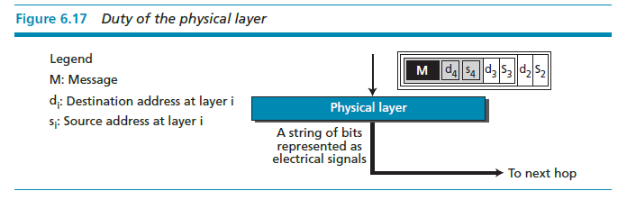

Slide 36
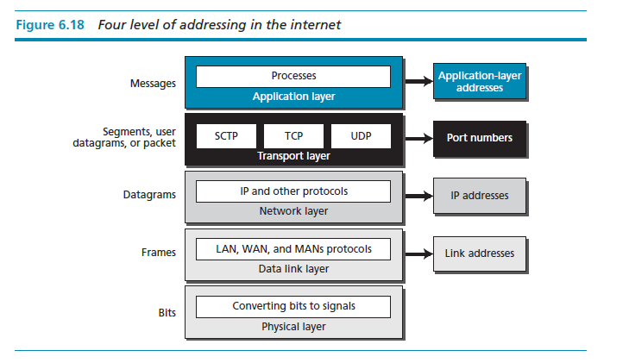
Summary of layers
Figure 6.18 summarizes the duties of each layer in the TCP/IP protocol and the addresses involved in each layer.

Slide 37
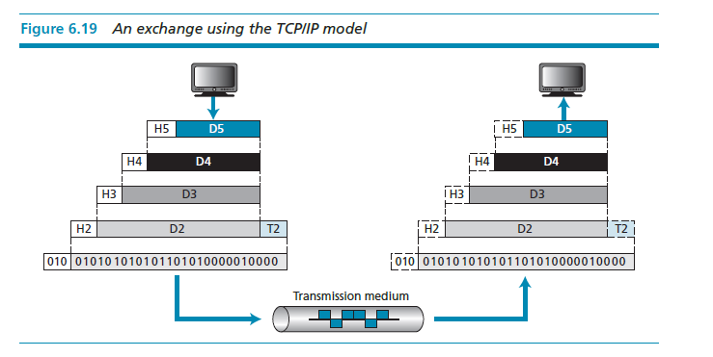

Slide 38
INTERNET APPLICATIONS
The main task of the Internet is to provide services for users. Among the most popular applications are electronic mail, remote login, file transfer, and accessing the World Wide Web (WWW). We briefly discuss these applications in this section.

Slide 39
Electronic-mail
Let us first discuss electronic mail (e-mail). Ironically, this first application that we discuss in this section cannot be supported by one client process and one server process. The reason is that e-mail is exchange of messages between two entities. Although the sender of the e-mail can be a client program, the receiver cannot be the corresponding server, because that implies that the receiver must let their computer run all the time, as they do not know when an e-mail will arrive. For this purpose, e-mail architecture is designed as shown in Figure 6.20.

Slide 40
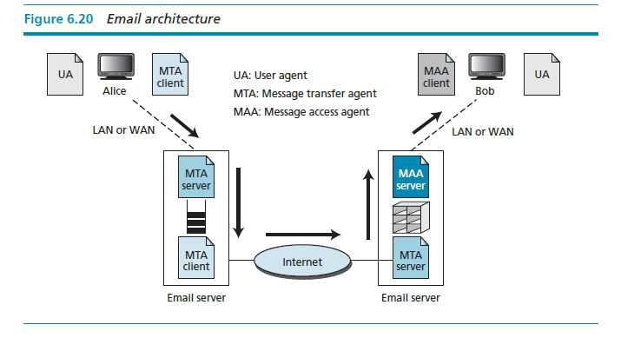

Slide 41
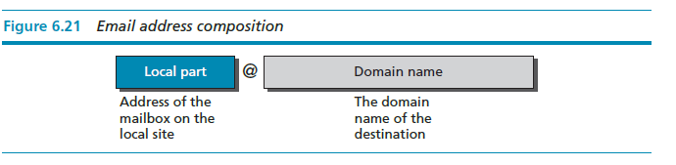
Mail access protocols
Stored e-mail remains on the mail server until it is retrieved by the recipient through an access protocol. Currently two e-mail access protocols are in common use: Post Office Protocol, Version 3 (POP3) and Internet Mail Access Protocol (IMAP).

Slide 42
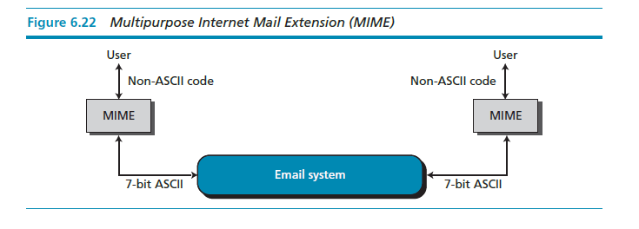
Multi-purpose Internet Mail Extension (MIME)
Multipurpose Internet Mail Extension (MIME) is a supplementary protocol that allows non-ASCII data to be sent through SMTP. MIME is not an e-mail protocol and cannot replace SMTP, it is only an extension to SMTP.

Slide 43
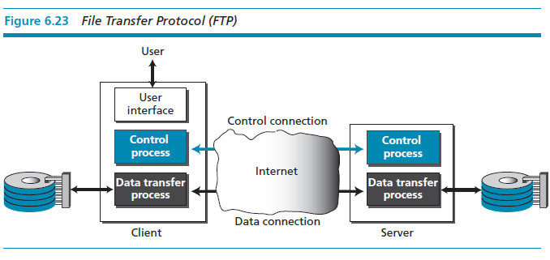
File Transfer Protocol (FTP)
File Transfer Protocol (FTP) is the standard mechanism for one of the most common tasks on the Internet, copying a file from one computer to another.

Slide 44
Remote login – TELNET
The main task of the application layer is to provide services for users. One way to satisfy these demands is to create different client-server application programs for each desired
service. Programs such as file transfer programs (FTP and SMTP), and so on are already available. However, it would be impossible to write a client-server program for each specific application.
TELNET is a general-purpose client-server program that lets a user access any application program on a remote computer. In other words, it allows the user to log onto a remote computer. After logging on, a user can use the services available on the remote computer and transfer the results back to the local computer.

Slide 45
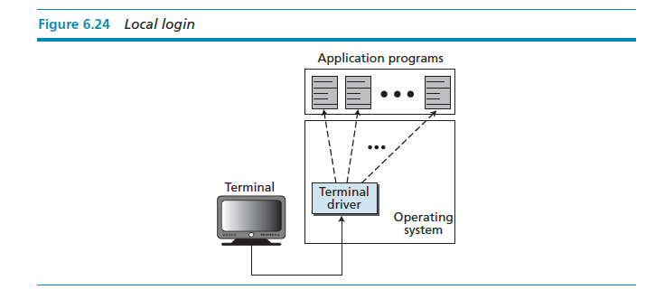

Slide 46
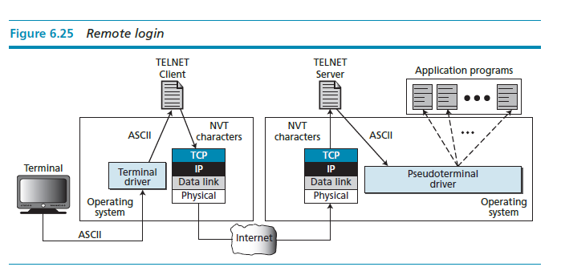

Slide 47
The World Wide Web (WWW)
The World Wide Web (WWW), or just “the Web”, is a repository of linked information spread all over the world. The WWW has a unique combination of flexibility, portability, and user-friendly features that distinguish it from other services provided by the Internet. The WWW today is a distributed client-server service in which a client using a browser can access a service using a server. However, the service provided is distributed over many locations, called web sites.

Slide 48
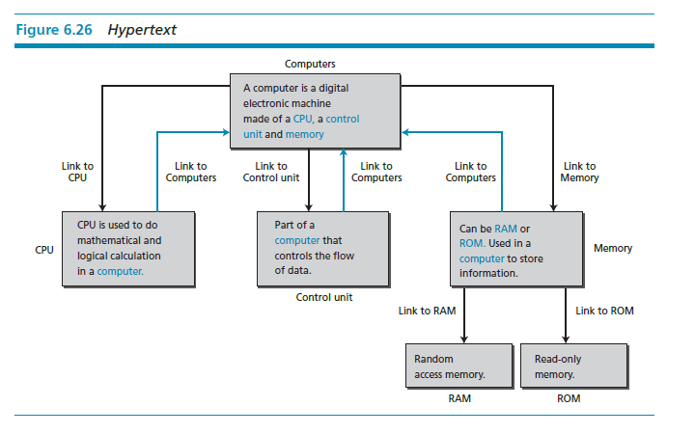
Hypertext and hypermedia
The WWW uses the concept of hypertext and hypermedia. In a hypertext environment, information is stored in a set of documents that are connected together using the concept of links.

Slide 49
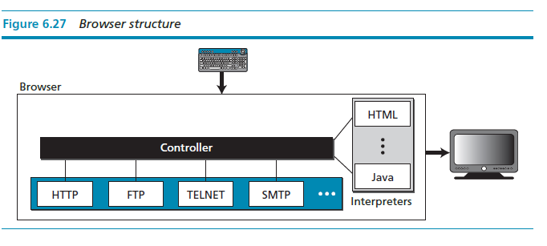
Components of WWW
To use the WWW we need three components: a browser, a web server, and a protocol called Hypertext Transfer Protocol (HTTP).

Slide 50
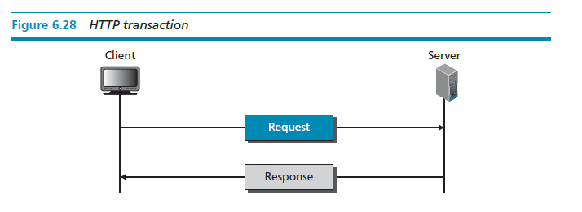
Hypertext Transfer Protocol (HTTP) is a protocol used mainly to access data on the World Wide Web.

Slide 51
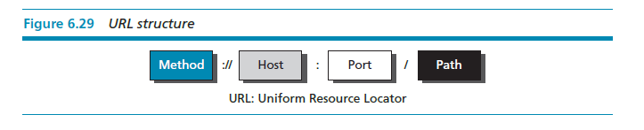
A client that wants to access a document needs an address. To facilitate the access of documents distributed throughout the world, HTTP uses the concept of locators. The uniform resource locator (URL) is a standard for specifying any kind of information on the Internet.

Slide 52
Static documents
The documents on the WWW can be grouped into three broad categories: static, dynamic, and active. This categorization is based on the time at which the contents of the document are determined. Static documents are fixed-content documents that are created and stored on a server.

Slide 53
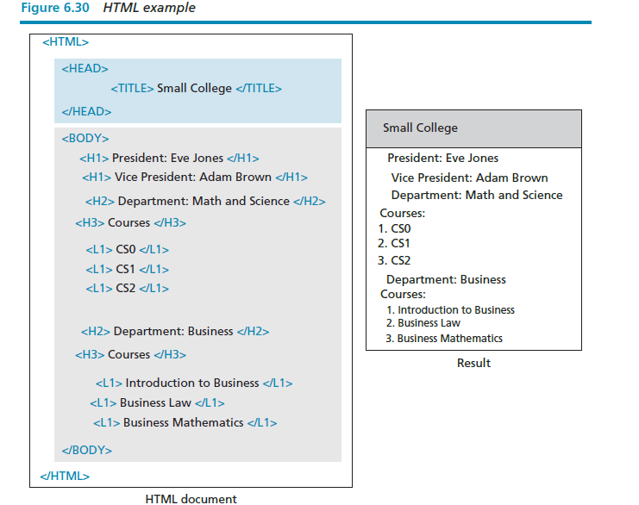
Hypertext Markup Language (HTML) is a language for creating Web pages.

Slide 54
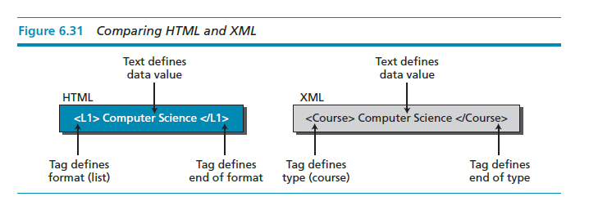
HTML adds formatting capability to a document, but it does not define the type of data. Extensible Markup Language (XML) is a language in which tags can be used to define the content (type) of the text between two tags.

Slide 55
Dynamic documents
A dynamic document is created by a Web server whenever a browser requests the document. When a request arrives, the Web server runs an application program that creates the dynamic document. The server returns the output of the program as a response to the browser that requested the document.

Slide 56
Active documents
For many applications we need to be able to run a program or a script at the client site. These are called active documents. For example, suppose we want to run a program that creates animated graphics on the screen, or a program that interacts with the user. The program definitely needs to be run on the client computer where the animation or interaction takes place. When a browser requests an active document, the server sends a copy of the document or a script. The document is then run under the control of the client’s browser.

Slide 57
Other Internet applications
During the last decades other applications have been developed on the Internet. These applications are not as popular as those discussed above, but they are gaining ground. We discuss a few of them here.

Slide 58
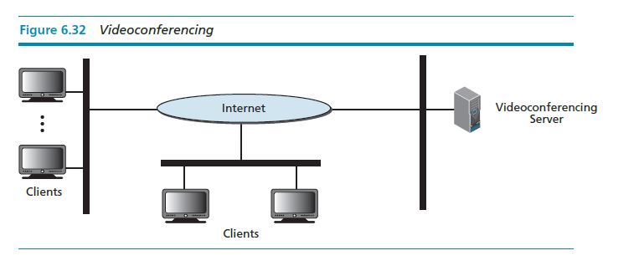
Videoconferencing
Videoconferencing can eliminate the cost of traveling, and save time and energy, by providing communication between two or more groups of participants or a set of individual participants.

Slide 59
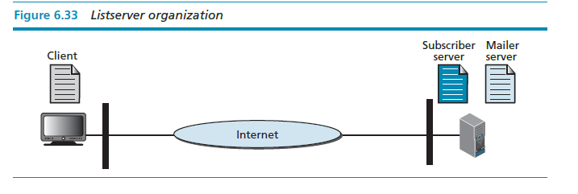
Group discussion Listservs
Another popular class of applications is listservs, which allow a group of users to discuss a common topic of interest.

Slide 60
Chat
Another populate class of Internet application is chat. This is a real-time application like videoconferencing, in which two or more parties are involved in an exchange of text and optionally audio and video. The two parties can send text to
each other, talk to each other (the same way as they might talk on the phone), and even see each other with suitable cameras.

