Slide 1
Chapter 5
Computer Organization

Slide 2
Objectives
After studying this chapter, the student should be able to:
List the three subsystems of a computer.
Describe the role of the central processing unit (CPU).
Describe the fetch-decode-execute phases of a cycle.
Describe the main memory and its addressing space.
Define the input/output subsystem.
Understand the interconnection of subsystems.
Describe different methods of input/output addressing.
Distinguish the two major trends in the design of computers.
Understand how computer throughput can be improved using pipelining and parallel processing.

Slide 3
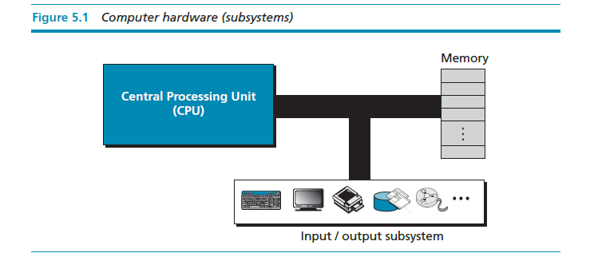
INTRODUCTION
We can divide the parts that make up a computer into three broad categories or subsystem: the central processing unit (CPU), the main memory, and the input/output subsystem.

Slide 4
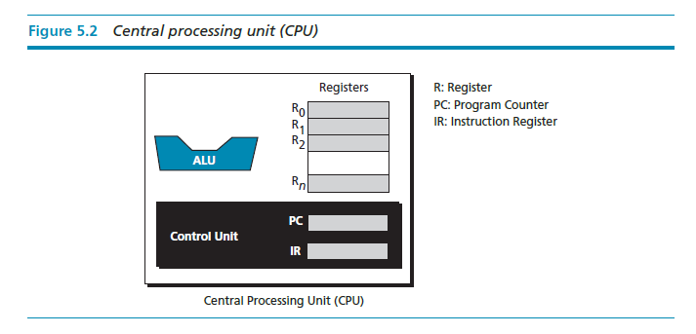
CENTRAL PROCESSING UNIT
The central processing unit (CPU) performs operations on data. In most architectures it has three parts: an arithmetic logic unit (ALU), a control unit, and a set of registers, fast storage locations.

Slide 5
The arithmetic logic unit (ALU)
The central processing unit (CPU) performs operations on data. In most architectures it has three parts: an arithmetic logic unit (ALU), a control unit, and a set of registers, fast storage locations (Figure 5.2).

Slide 6
Registers
Registers are fast stand-alone storage locations that hold data temporarily. Multiple registers are needed to facilitate the operation of the CPU. Some of these registers are shown in Figure 5.2.

Slide 7
The control unit
The third part of any CPU is the control unit. The control unit controls the operation of each subsystem. Controlling is achieved through signals sent from the control unit to other subsystems.

Slide 8
MAIN MEMORY
Main memory is the second major subsystem in a computer (Figure 5.3). It consists of a collection of storage locations, each with a unique identifier, called an address. Data is transferred to and from memory in groups of bits called words. A word can be a group of 8 bits, 16 bits, 32 bits, or 64 bits (and growing). If the word is 8 bits, it is referred to as a byte. The term “byte” is so common in computer science that sometimes a 16-bit word is referred to as a 2-byte word, or a 32-bit word is referred to as a 4-byte word.

Slide 9
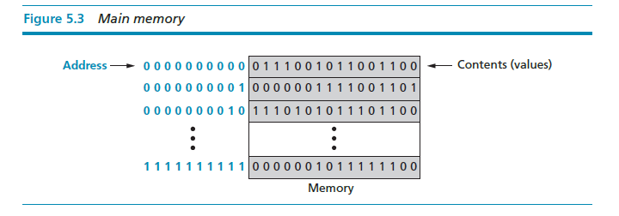

Slide 10
Address space
To access a word in memory requires an identifier. Although programmers use a name to identify a word (or a collection of words), at the hardware level each word is identified by an address. The total number of uniquely identifiable locations in memory is called the address space. For example, a memory with 64 kilobytes and a word size of 1 byte has an address space that ranges from 0 to 65,535.

Slide 11
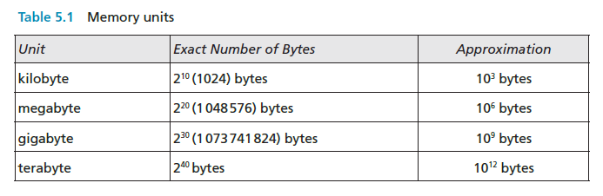

Slide 12
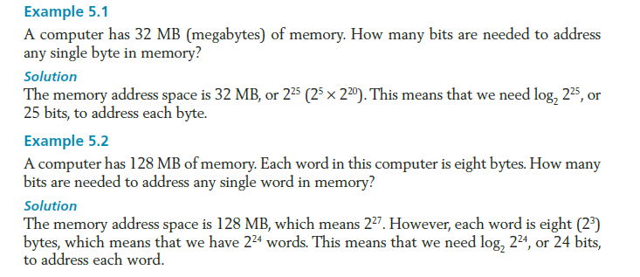

Slide 13
Memory types
Two main types of memory exist: RAM and ROM.
Random access memory (RAM)
Static RAM (SRAM)
Dynamic RAM (DRAM)
Read-only memory (ROM)
Programmable read-only memory (PROM).
Erasable programmable read-only memory (EPROM).
Electrically erasable programmable read-only memory (EEPROM).

Slide 14
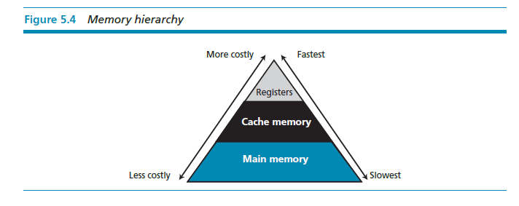
Memory hierarchy
Computer users need a lot of memory, especially memory that is very fast and inexpensive. This demand is not always possible to satisfy—very fast memory is usually not cheap. A compromise needs to be made. The solution is hierarchical levels of memory.

Slide 15
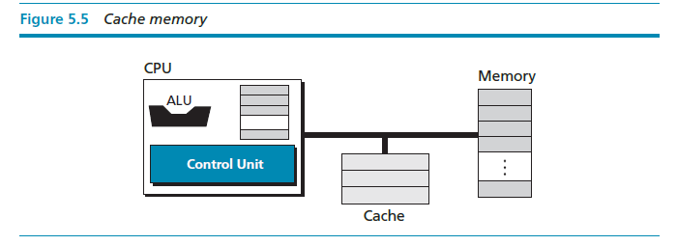
Cache memory
Cache memory is faster than main memory but slower than the CPU and its registers. Cache memory, which is normally small in size, is placed between the CPU and main memory (Figure 5.5).

Slide 16
INPUT/OUTPUT SUBSYSTEM
The third major subsystem in a computer is the collection of devices referred to as the input/output (I/O) subsystem. This subsystem allows a computer to communicate with the outside world, and to store programs and data even when the power is off. Input/output devices can be divided into two broad categories: non-storage and storage devices.

Slide 17
Non-storage devices
Non-storage devices allow the CPU/memory to communicate with the outside world, but they cannot store information.
Keyboard and monitor
Printer

Slide 18
Storage devices
Storage devices, although classified as I/O devices, can store large amounts of information to be retrieved at a later time. They are cheaper than main memory, and their contents are nonvolatile—that is, not erased when the power is turned off. They are sometimes referred to as auxiliary storage devices. We can categorize them as either magnetic or optical.

Slide 19
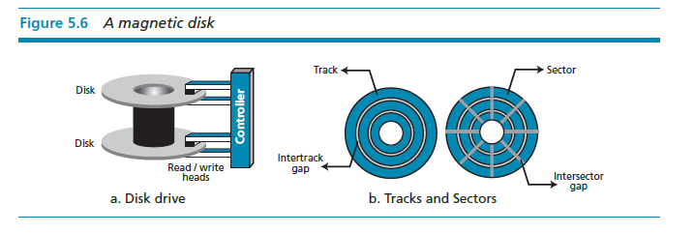
Magnetic storage devices

Slide 20
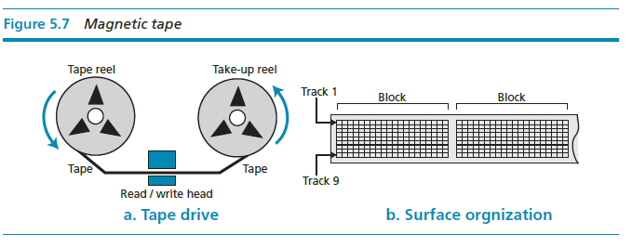

Slide 21
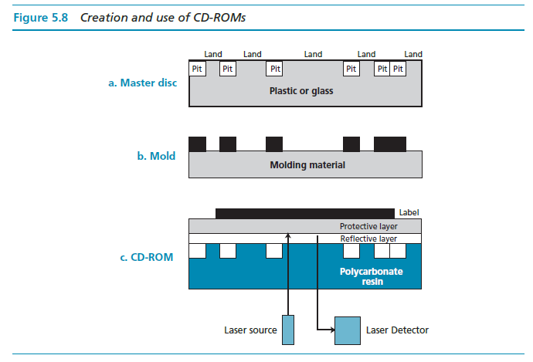
Optical storage devices

Slide 22
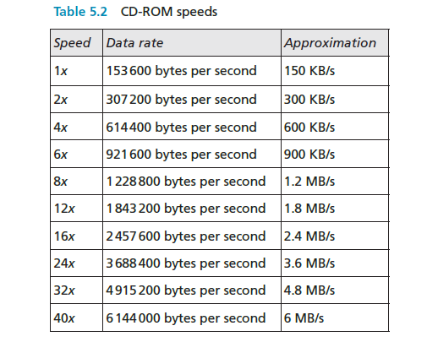

Slide 23
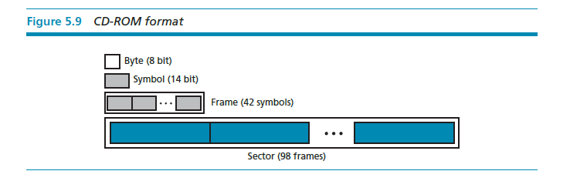

Slide 24
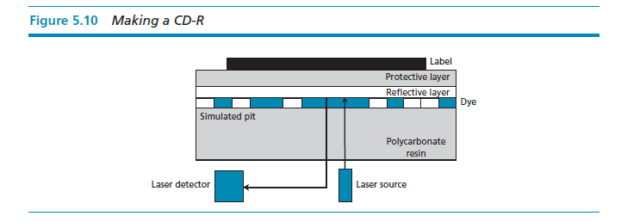

Slide 25
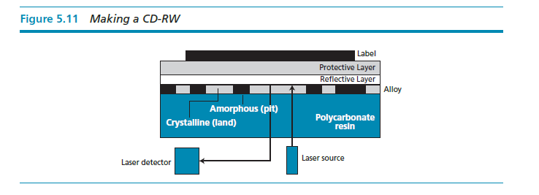

Slide 26
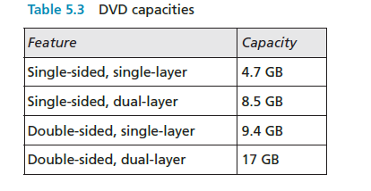

Slide 27
SUBSYSTEM INTERCONNECTION
The previous sections outlined the characteristics of the three subsystems (CPU, main memory, and I/O) in a stand-alone computer. In this section, we explore how these three subsystems are interconnected. The interconnection plays an important role because information needs to be exchanged between the three subsystems.

Slide 28
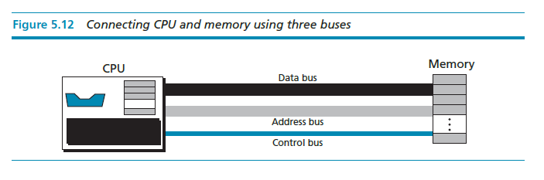
Connecting CPU and memory
The CPU and memory are normally connected by three groups of connections, each called a bus: data bus, address bus, and control bus (Figure 5.12).

Slide 29
Connecting I/O devices
I/O devices cannot be connected directly to the buses that connect the CPU and memory because the nature of I/O devices is different from the nature of CPU and memory. I/O devices are electromechanical, magnetic, or optical devices, whereas the CPU and memory are electronic devices. I/O devices also operate at a much slower speed than the CPU/memory. There is a need for some sort of intermediary
to handle this difference. Input/output devices are therefore attached to the buses through input/output controllers or interfaces. There is one specific controller for each input/output device (Figure 5.13).

Slide 30
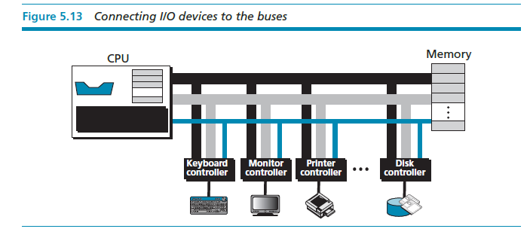

Slide 31
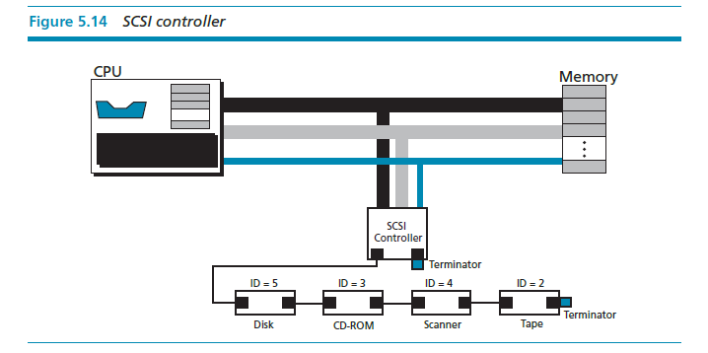

Slide 32
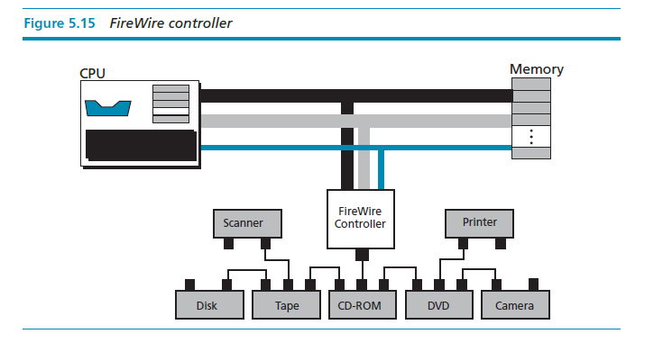

Slide 33
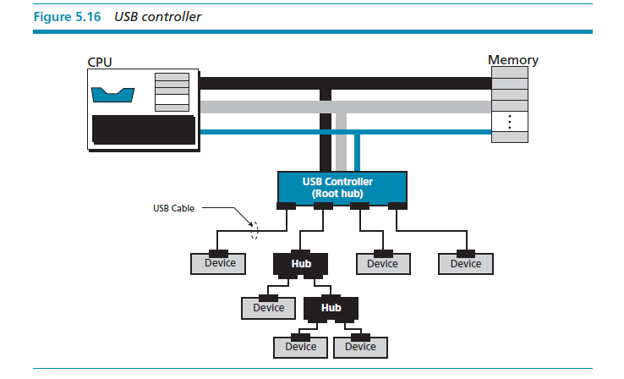

Slide 34
Addressing input/output devices
The CPU usually uses the same bus to read data from or write data to main memory and I/O device. The only difference is the instruction. If the instruction refers to a word in main memory, data transfer is between main memory and the CPU. If the instruction identifies an I/O device, data transfer is between the I/O device and the CPU. There are two methods for handling the addressing of I/O devices: isolated I/O and memory-mapped I/O.

Slide 35
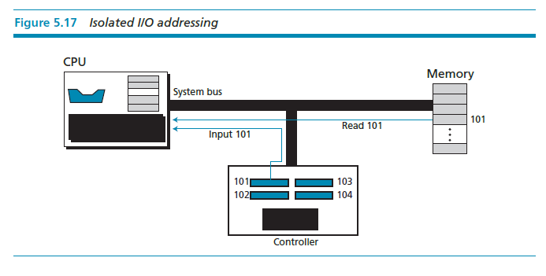

Slide 36
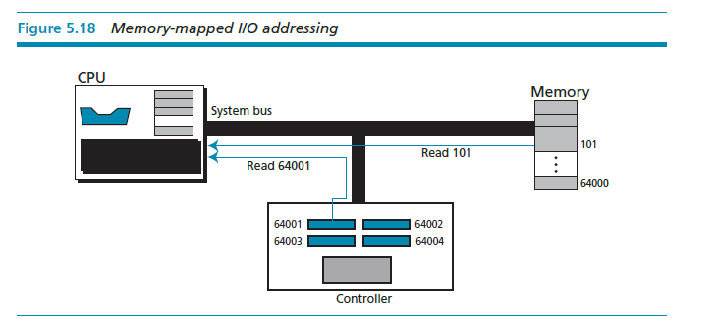

Slide 37

PROGRAM EXECUTION
Today, general-purpose computers use a set of instructions called a program to process data. A computer executes the program to create output data from input data. Both the program and the data are stored in memory.

Slide 38
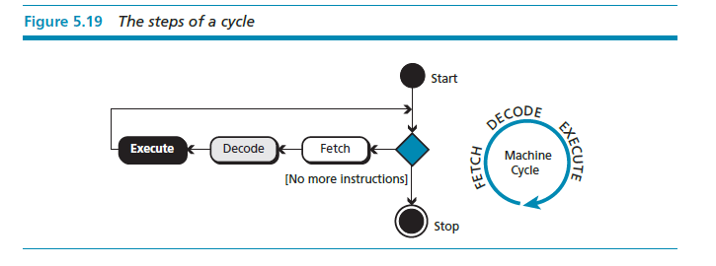
Machine cycle
The CPU uses repeating machine cycles to execute instructions in the program, one by one, from beginning to end. A simplified cycle can consist of three phases: fetch, decode, and execute (Figure 5.19).

Slide 39
Input/output operation
Commands are required to transfer data from I/O devices to the CPU and memory. Because I/O devices operate at much slower speeds than the CPU, the operation of the CPU must be somehow synchronized with the I/O devices. Three methods have been devised for this synchronization: programmed I/O, interrupt driven I/O, and direct memory access (DMA).
Programmed I/O
Interrupt driven I/O
Direct memory access (DMA

Slide 40
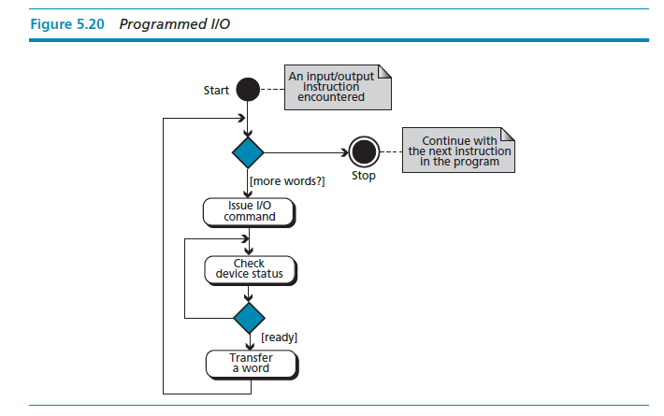

Slide 41
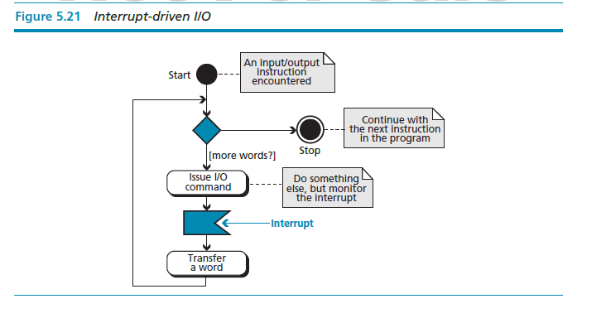

Slide 42
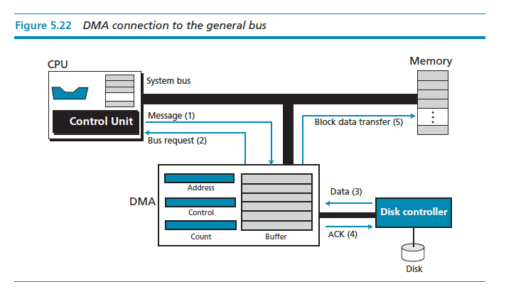

Slide 43
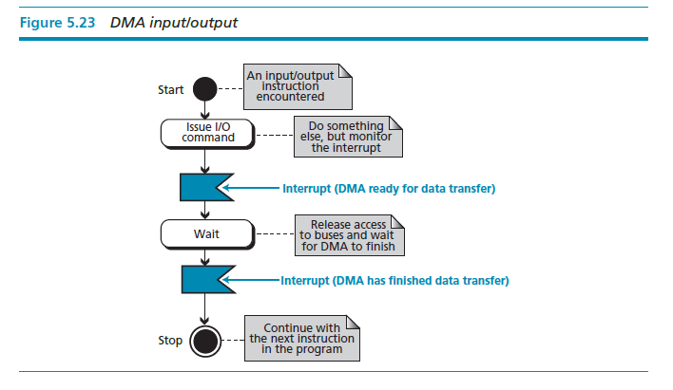

Slide 44
DIFFERENT ARCHITECTURES
The architecture and organization of computers has gone through many changes in recent decades. In this section we discuss some common architectures and organization that differ from the simple computer architecture we discussed earlier.

Slide 45
CISC
CISC (pronounced sisk) stands for complex instruction set computer (CISC). The strategy behind CISC architectures is to have a large set of instructions, including complex ones. Programming CISC-based computers is easier than in other designs because there is a single instruction for both simple and complex tasks. Programmers therefore do not have to write a set of instructions to do a complex task.

Slide 46
RISC
RISC (pronounced risk) stands for reduced instruction set computer. The strategy behind RISC architecture is to have a small set of instructions that do a minimum number of simple operations. Complex instructions are simulated using a subset of simple instructions. Programming in RISC is more difficult and time-consuming than in the other design because most of the complex instructions are simulated using simple instructions.

Slide 47
Pipelining
We have learned that a computer uses three phases of fetch, decode, and execute for each instruction. In early computers, these three phases needed to be done in series for each instruction. In other words, instruction n needs to finish all of these phases before the instruction n + 1 can start its own phases. Modern computers use a technique called pipelining to improve the throughput (the total number of instructions performed in each period of time). The idea is that if the control unit can do two or three of these phases simultaneously, the next instruction can start before the previous one is finished.

Slide 48
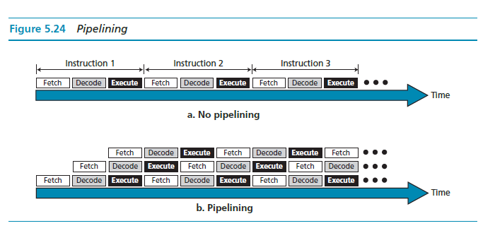

Slide 49
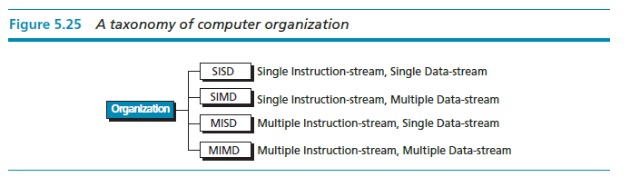
Parallel processing
Traditionally a computer had a single control unit, a single arithmetic logic unit, and a single memory unit. With the evolution in technology and the drop in the cost of computer hardware, today we can have a single computer with multiple control units, multiple arithmetic logic units and multiple memory units. This idea is referred to as parallel processing. Like pipelining, parallel processing can improve
throughput.

Slide 50
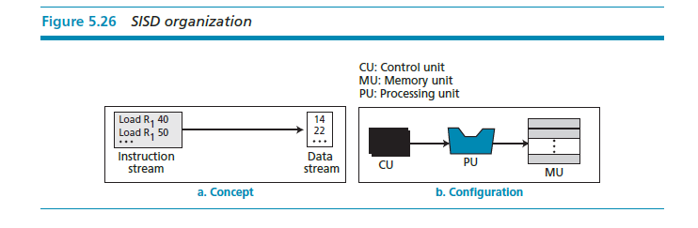

Slide 51
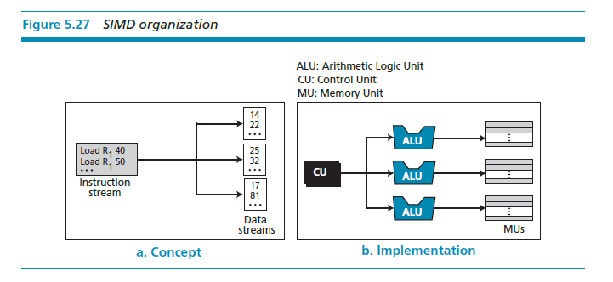

Slide 52
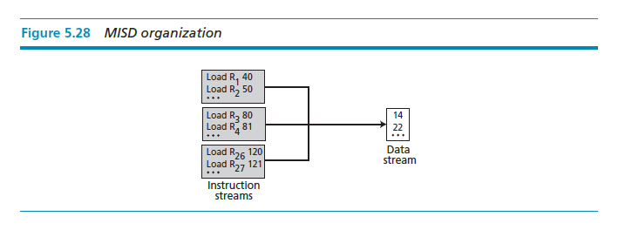

Slide 53
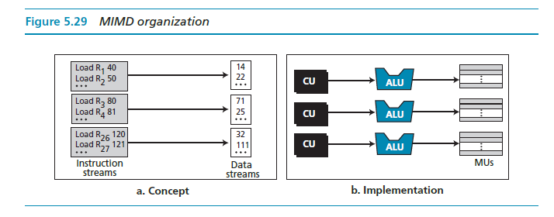

Slide 54
A SIMPLE COMPUTER
To explain the architecture of computers as well as their instruction processing, we introduce a simple (unrealistic) computer, as shown in Figure 5.30. Our simple computer has three components: CPU, memory, and an input/output subsystem.

Slide 55
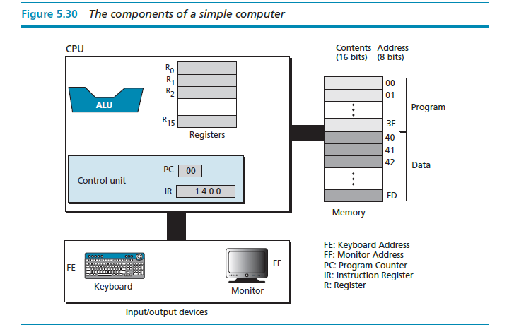

Slide 56
Instruction set
Our simple computer is capable of having a set of sixteen instructions, although we are using only fourteen of these instructions. Each computer instruction consists of two parts: the operation code (opcode) and the operand (s). The opcode specifies the type of operation to be performed on the operand (s). Each instruction consists of sixteen bits divided into four 4-bit fields. The leftmost field contains the opcode and the other three fields contains the operand or address of operand (s), as shown in Figure 5.31.

Slide 57
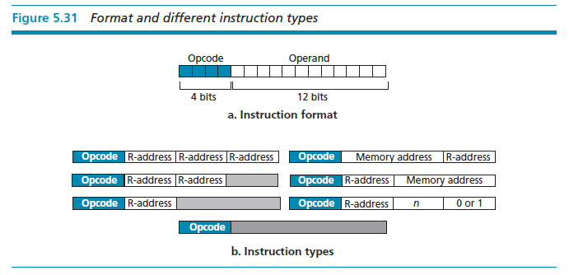

Slide 58
Processing the instructions
Our simple computer, like most computers, uses machine cycles. A cycle is made of three phases: fetch, decode, and execute. During the fetch phase, the instruction whose address is determined by the PC is obtained from the memory and loaded into the IR. The PC is then incremented to point to the next instruction. During the decode phase, the instruction in IR is decoded and the required operands are fetched from the register or from memory. During the execute phase, the instruction is executed and the results are placed in the appropriate memory location or the register. Once the third phase is completed, the control unit starts the cycle again, but now the PC is pointing to the next instruction. The process continues until the CPU reaches a HALT instruction.

Slide 59
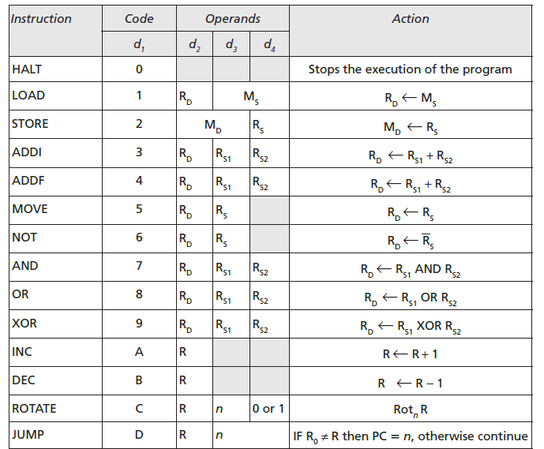
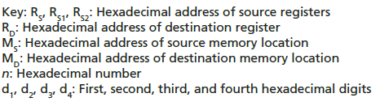

Slide 60
An example
Let us show how our simple computer can add two integers A and B and create the result as C. We assume that integers are in two’s complement format. Mathematically, we show this operation as:
We assume that the first two integers are stored in memory locations (40)₁₆ and (41)₁₆ and the result should be stored in
memory location (42)₁₆. To do the simple addition needs five instructions, as shown next:

Slide 61
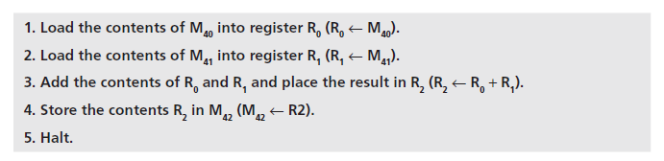
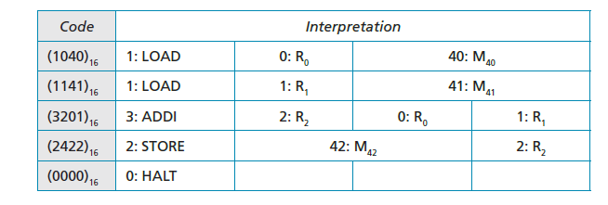
In the language of our simple computer, these five instructions are encoded as:

Slide 62
Storing program and data
We can store the five-line program in memory starting from location (00)₁₆ to (04)₁₆. We already know that the data needs to be stored in memory locations (40)16, (41)16, and (42)16.
Cycles
Our computer uses one cycle per instruction. If we have a small program with five instructions, we need five cycles. We also know that each cycle is normally made up of three steps: fetch, decode, execute. Assume for the moment that we need to add 161 + 254 = 415. The numbers are shown in memory in hexadecimal is, (00A1)₁₆, (00FE)₁₆, and (019F)₁₆.

Slide 63
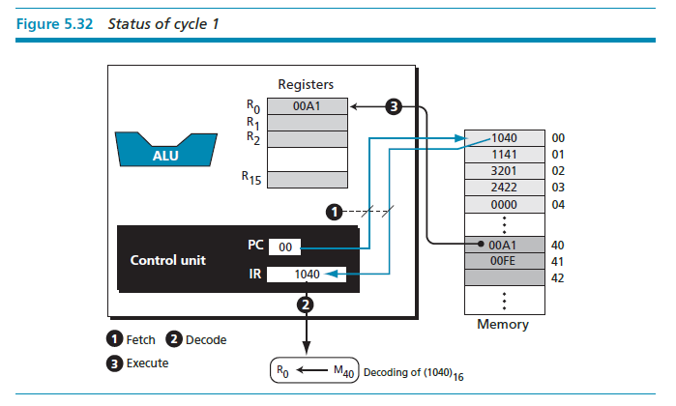

Slide 64
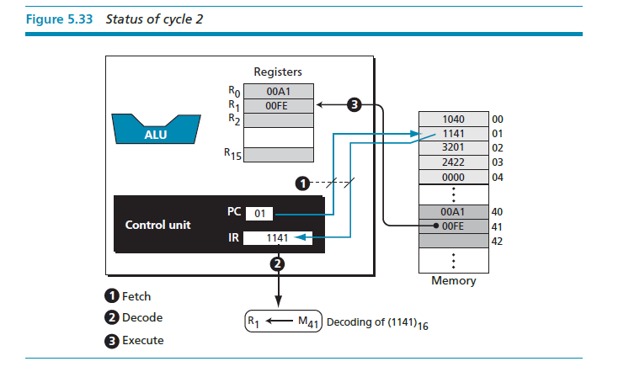

Slide 65
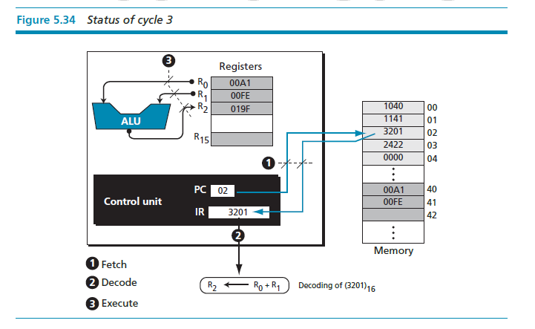

Slide 66
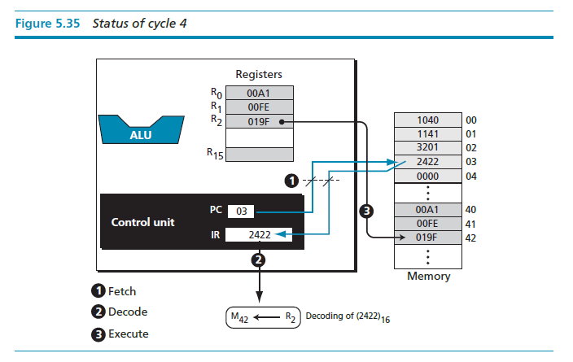

Slide 67
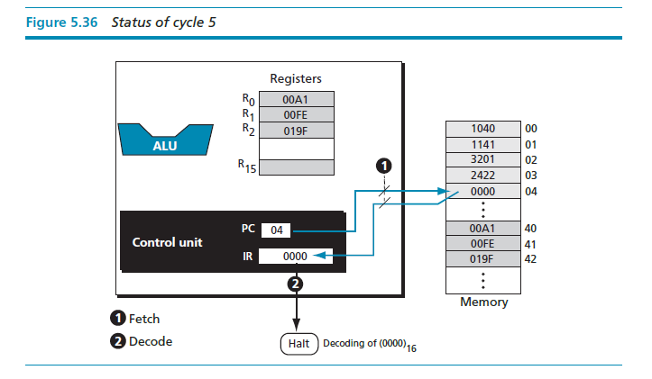

Slide 68
Another example
In the previous example we assumed that the two integers to be added were already in memory. We also assume that the result of addition will be held in memory. You may ask how we can store the two integers we want to add in memory, or how we use the result when it is stored in the memory. In a real situation, we enter the first two integers into memory using an input device such as keyboard, and we display the third integer through an output device such as a monitor. Getting data via an input device is normally called a read operation, while sending data to an output device is normally called a write operation. To make our previous program more practical, we need modify it as follows:

Slide 69
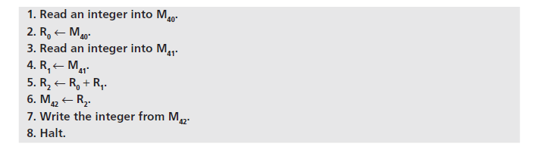
In our computer we can simulate read and write operations using the LOAD and STORE instruction. Furthermore, LOAD and STORE read data input to the CPU and write data from the CPU. We need two instructions to read data into memory or write data out of memory. The read operation is:

Slide 70

The write operation is:

Slide 71
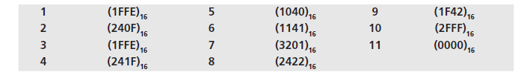
The program is coded as:
Operations 1 to 4 are for input and operations 9 and 10 are for output. When we run this program, it waits for the user to input two integers on the keyboard and press the enter key. The program then calculates the sum and displays the result on the monitor.

