Slide 1
Chapter 4
Operations on Data

Slide 2
Objectives
After studying this chapter, the student should be able to:
List the three categories of operations performed on data.
Perform unary and binary logic operations on bit patterns.
Distinguish between logic shift operations and arithmetic shift operations.
Perform logic shift operations on bit patterns.
Understand some applications of logic and shift operations such as setting, unsetting, and flipping bits.
Perform arithmetic shift operation on integers whey they are stored in two’ complement format.
Perform addition and subtraction operations on reals when they are stored in sign and magnitude format.

Slide 3
LOGIC OPERATIONS
In Chapter 3 we discussed the fact that data inside a computer is stored as patterns of bits. Logic operations refer to those operations that apply the same basic operation on individual bits of a pattern, or on two corresponding bits in two patterns. This means that we can define logic operations at the bit level and at the pattern level. A logic operation at the pattern level is n
logic operations, of the same type, at the bit level where n is the number of bits in the pattern.

Slide 4
Logic operations at bit level
A bit can take one of the two values: 0 or 1. If we interpret 0 as the value false and 1 as the value true, we can apply the operations defined in Boolean algebra to manipulate bits. Boolean algebra, named in honor of George Boole, belongs to a special field of mathematics called logic. Boolean algebra and its application to building logic circuits in computers are briefly discussed in Appendix E. In this section, we show briefly four bit-level operations that are used to manipulate bits: NOT, AND, OR, and XOR.

Slide 5
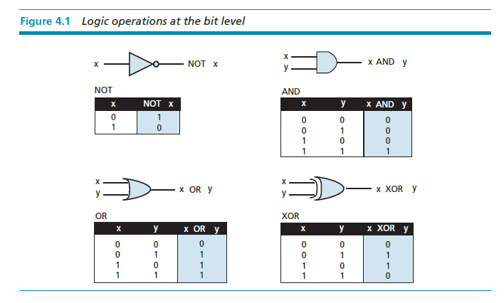

Slide 6
NOT
The NOT operator is a unary operator: it takes only one input. The output bit is the complement of the input.
AND
The AND operator is a binary operator: it takes two inputs. The output bit is 1 if both inputs are 1s and the output is 0 in the other three cases.

Slide 7
OR
The OR operator is a binary operator: it takes two inputs. The output bit is 0 if both inputs are 0s and the output is 1 in other three cases.
XOR
The XOR operator is a binary operator like the OR operator, with only one difference: the output is 0 if both inputs are 1s.

Slide 8
In English we use the conjunction “or” sometimes to means an inclusive-or, and sometimes to means an exclusive-or.
The sentence “I wish to have a car or a house” uses “or” in the inclusive sense—I wish a car, a house, or both.
The sentence “Today is either Monday or Tuesday” uses “or” in the exclusive sense—today is either Monday or Tuesday, but it cannot be both.

Slide 9
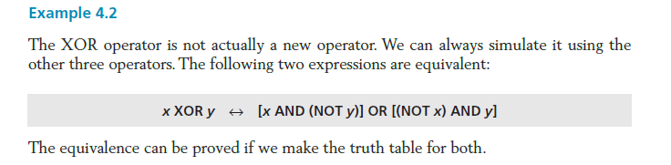

Slide 10
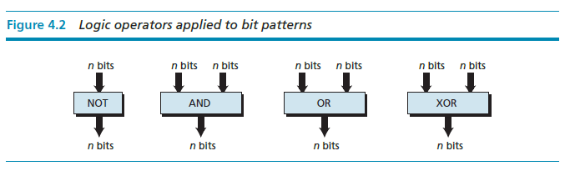
Logic operations at pattern level
The same four operators (NOT, AND, OR, and XOR) can be applied to an n-bit pattern. The effect is the same as applying each operator to each individual bit for NOT and to each corresponding pair of bits for other three operators. Figure 4.2 shows these four operators with input and output patterns.

Slide 11
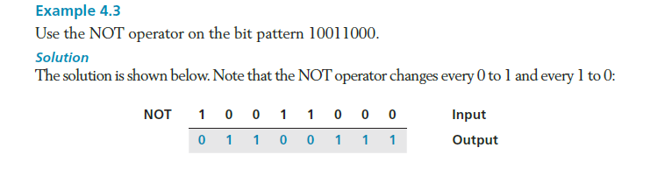

Slide 12
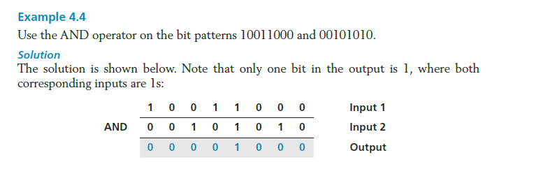

Slide 13
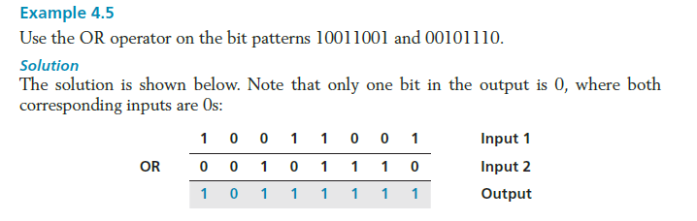

Slide 14
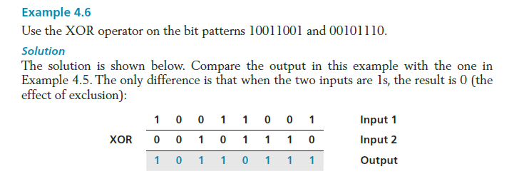

Slide 15
Applications
The four logic operations can be used to modify a bit pattern.
Complementing (NOT)
Unsetting (AND)
Setting (OR)
Flipping (XOR)

Slide 16
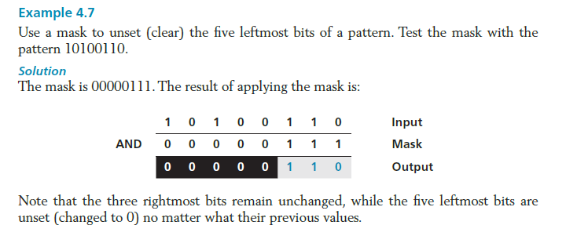

Slide 17
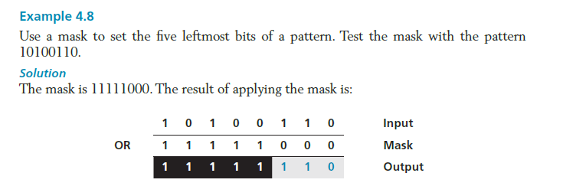

Slide 18
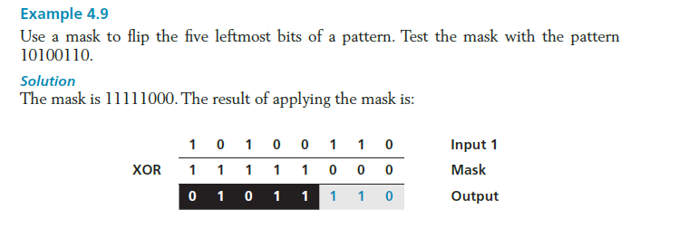

Slide 19
SHIFT OPERATIONS
Shift operations move the bits in a pattern, changing the positions of the bits. They can move bits to the left or to the right. We can divide shift operations into two categories: logical shift operations and arithmetic shift operations.

Slide 20
Logical shift operations
A logical shift operation is applied to a pattern that does not represent a signed number. The reason is that these shift operation may change the sign of the number that is defined by the leftmost bit in the pattern. We distinguished two types of logical shift operations, as described below:
Logical shift
Logical circular shift (Rotate)

Slide 21
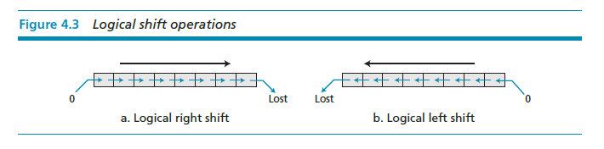

Slide 22
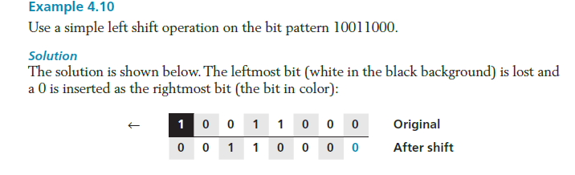

Slide 23
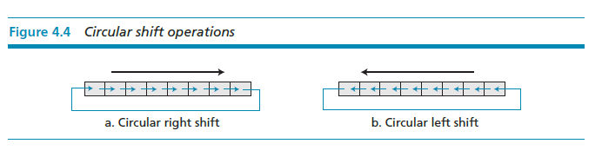

Slide 24
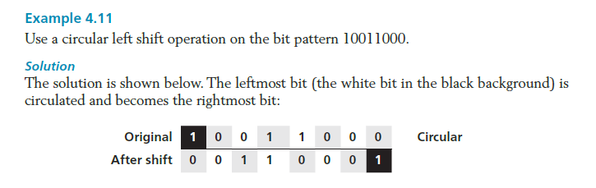

Slide 25
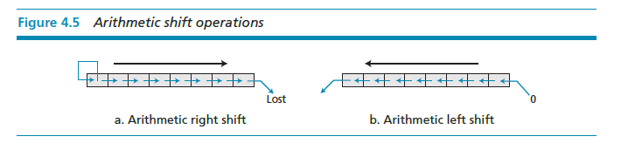
Arithmetic shift operations
Arithmetic shift operations assume that the bit pattern is a signed integer in two’s complement format. Arithmetic right shift is used to divide an integer by two, while arithmetic left shift is used to multiply an integer by two.

Slide 26
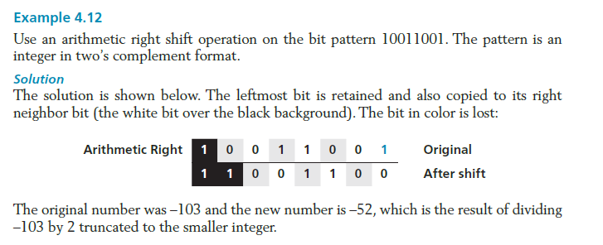

Slide 27
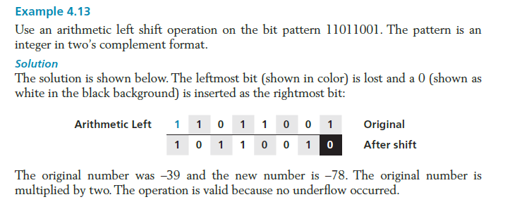

Slide 28
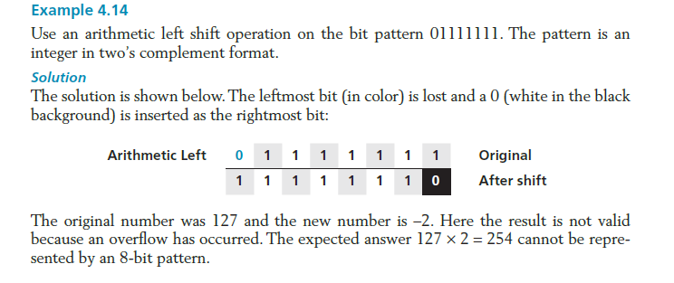

Slide 29
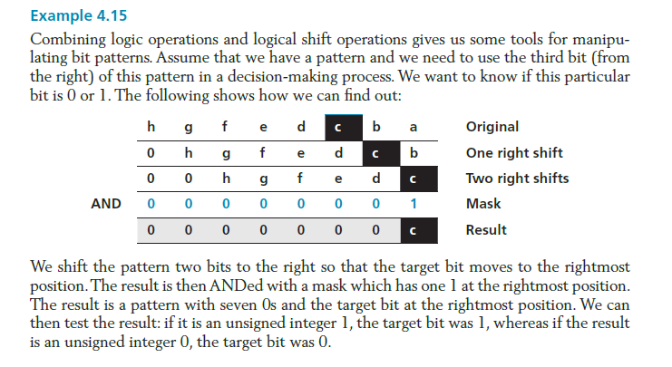

Slide 30
ARITHMETIC OPERATIONS
Arithmetic operations involve adding, subtracting, multiplying, and dividing. We can apply these operations to integers and floating-point numbers.

Slide 31
Arithmetic operations on integers
All arithmetic operations such as addition, subtraction, multiplication, and division can be applied to integers. Although multiplication (division) of integers can be implemented using repeated addition (subtraction), the procedure is not efficient. There are more efficient procedures for multiplication and division, such as Booth procedures, but these are beyond the scope of this book. For this reason, we only discuss addition and subtraction of integers here.

Slide 32
Two’s complement integers
When the subtraction operation is encountered, the computer simply changes it to an addition operation, but makes two’s complement of the second number. In other words:

Slide 33
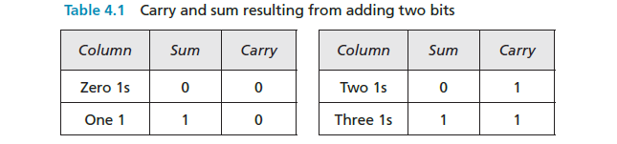
We should remember that we add integers column by column. The following table shows the sum and carry (C).

Slide 34
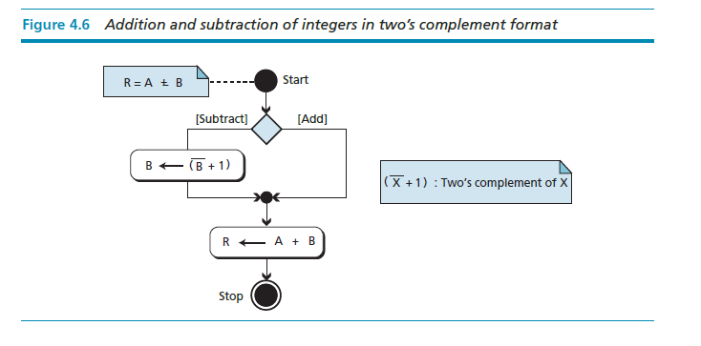

Slide 35
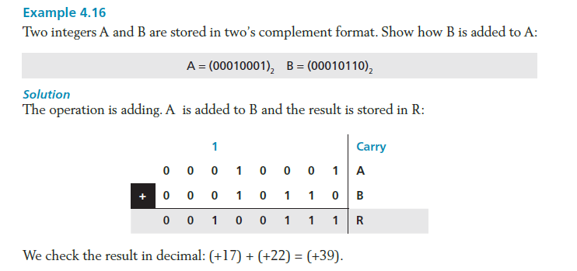

Slide 36
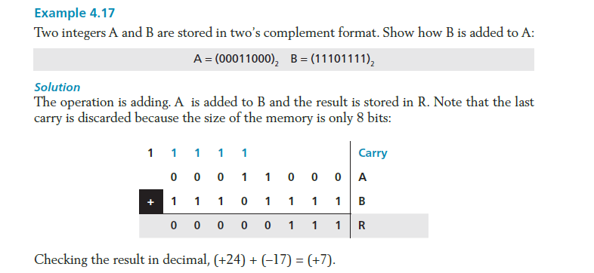

Slide 37
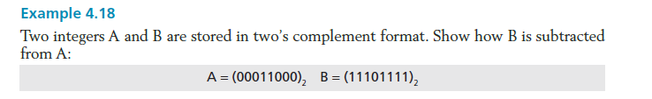
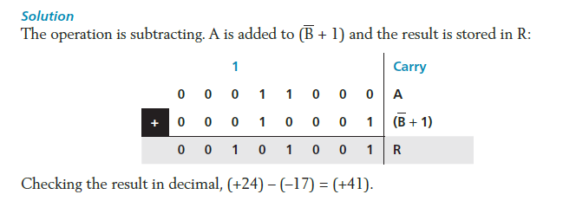

Slide 38
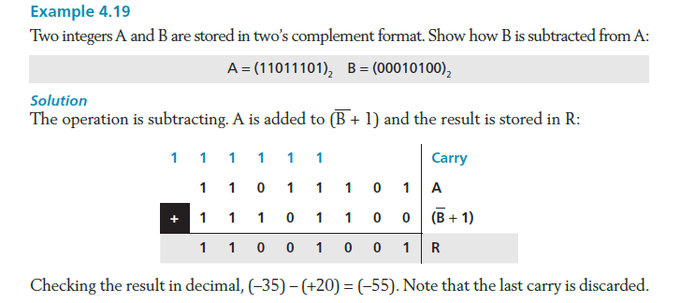

Slide 39
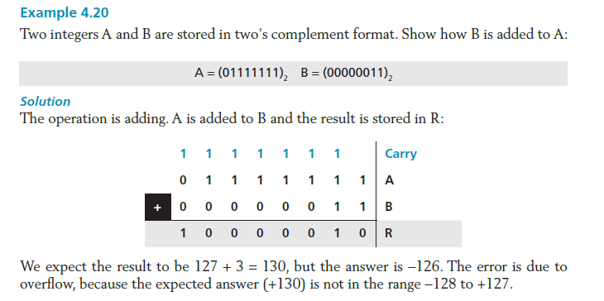

Slide 40


Slide 41
Sign-and-magnitude integers
Addition and subtraction for integers in sign-and-magnitude representation looks very complex. We have four different combination of signs (two signs, each of two values) for addition, and four different conditions for subtraction. This means that we need to consider eight different situations. However, if we first check the signs, we can reduce these cases, as shown in Figure 4.7.

Slide 42
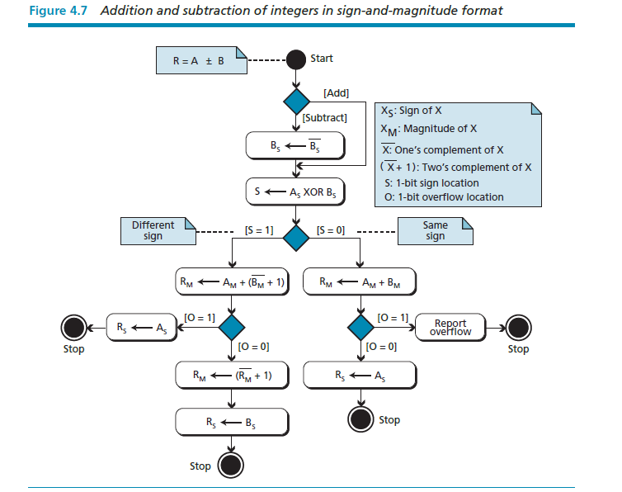

Slide 43
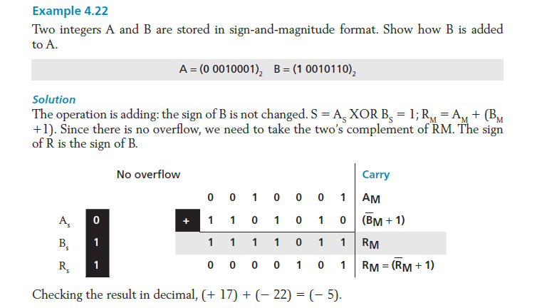

Slide 44
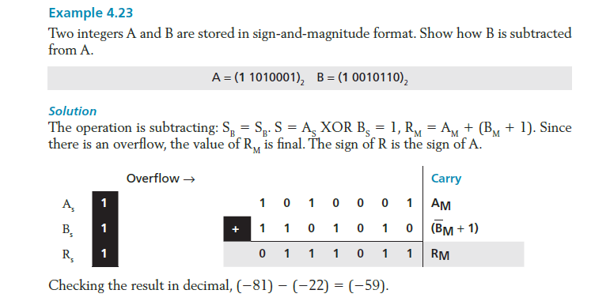

Slide 45
Arithmetic operations on reals
All arithmetic operations such as addition, subtraction, multiplication, and division can be applied to reals stored in floating-point format. Multiplication of two reals involves multiplication of two integers in sign-and-magnitude representation. Division of two reals involves division of two integers in sign-and-magnitude representations. Since we did not discuss the multiplication or division of integers in sign-and magnitude representation, we will not discuss the multiplication and division of reals, and only show addition and subtractions for reals.

Slide 46
Addition and subtraction of reals
Addition and subtraction of real numbers stored in floating-point numbers is reduced to addition and subtraction of two integers stored in sign-and-magnitude (combination of sign and mantissa) after the alignment of decimal points. Figure 4.8 shows a simplified version of the procedure (there are some special cases that we have ignored).

Slide 47
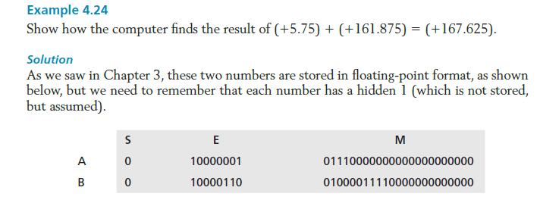

Slide 48
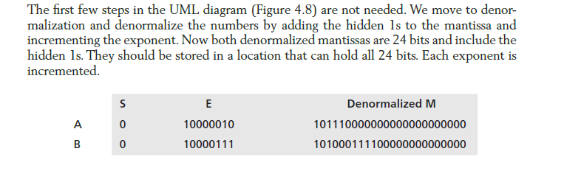
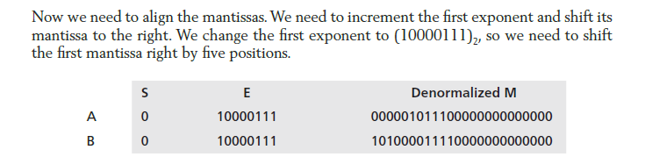

Slide 49
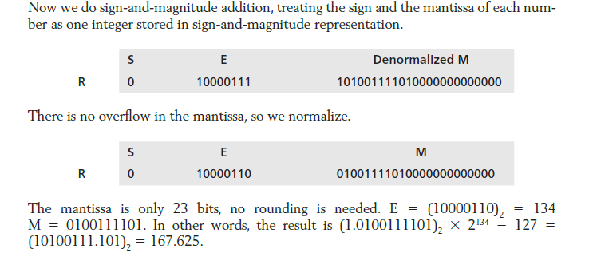

Slide 50
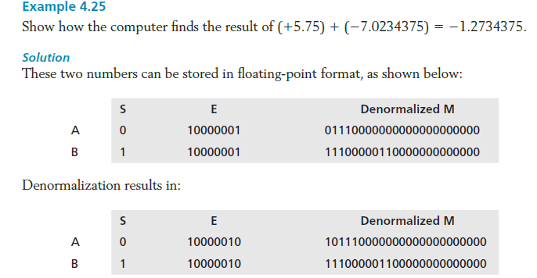

Slide 51
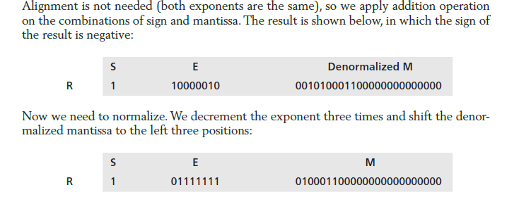

Slide 52
