Slide 1
Chapter 3
Data Storage

Slide 2
Objectives
After studying this chapter, the student should be able to:
List five different data types used in a computer.
Describe how different data is stored inside a computer.
Describe how integers are stored in a computer.
Describe how reals are stored in a computer.
Describe how text is stored in a computer using one of the various encoding systems.
Describe how audio is stored in a computer using sampling, quantization, and encoding.
Describe how images are stored in a computer using raster and vector graphics schemes.
Describe how video is stored in a computer as a representation of images changing in time.

Slide 3
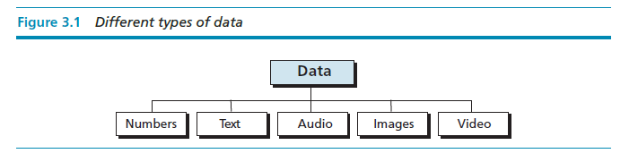
INTRODUCTION
Data today come in different forms including numbers, text, audio, image, and video (Figure 3.1).

Slide 4


Slide 5
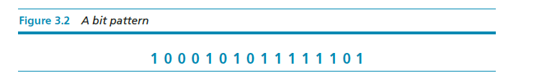
Data inside the computer
All data types are transformed into a uniform representation when they are stored in a computer and transformed back to their original form when retrieved. This universal representation is called a bit pattern.

Slide 6
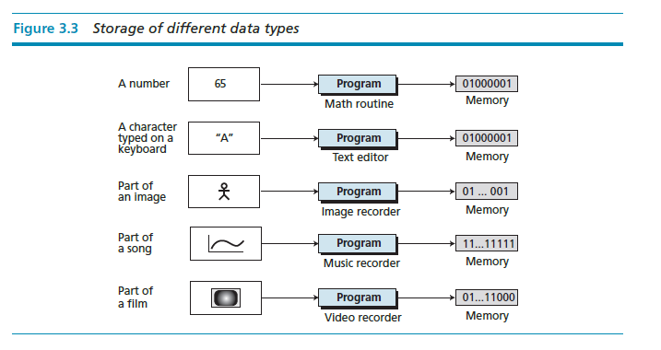

Slide 7
Data compression
To occupy less memory space, data is normally compressed before being stored in the computer. Data compression is a very broad and involved subject, so we have dedicated the whole of Chapter 16 to this subject.

Slide 8
Error detection and correction
Another issue related to data is the detection and correction of errors during transmission or storage. We discuss this issue briefly in Appendix H.

Slide 9
STORING NUMBERS
A number is changed to the binary system before being stored in the computer memory, as described in Chapter 2. However, there are still two issues that need to be handled:
How to store the sign of the number.
How to show the decimal point.

Slide 10
Storing integers
Integers are whole numbers (numbers without a fractional part). For example, 134 and −125 are integers, whereas 134.23 and −0.235 are not. An integer can be thought of as a number in which the position of the decimal point is fixed: the decimal point is to the right of the least significant (rightmost) bit. For this reason, fixed-point representation is used to store an integer, as shown in Figure 3.4. In this representation the decimal point is assumed but not stored.

Slide 11
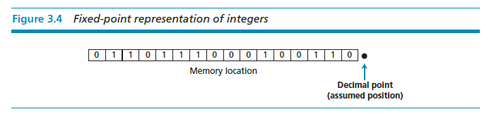

Slide 12
Unsigned representation
An unsigned integer is an integer that can never be negative and can take only 0 or positive values. Its range is between 0 and positive infinity.
An input device stores an unsigned integer using the following steps:
The integer is changed to binary.
If the number of bits is less than n, 0s are added to the left.

Slide 13
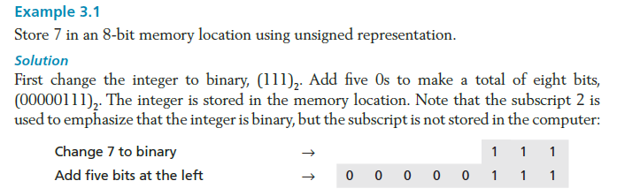

Slide 14
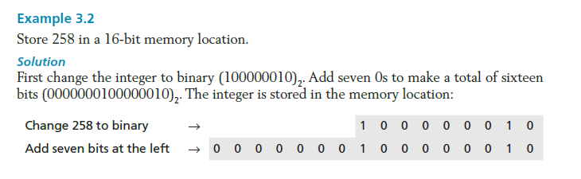

Slide 15
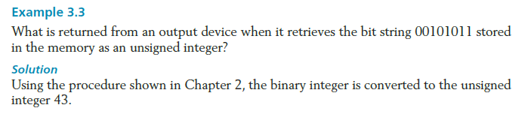

Slide 16
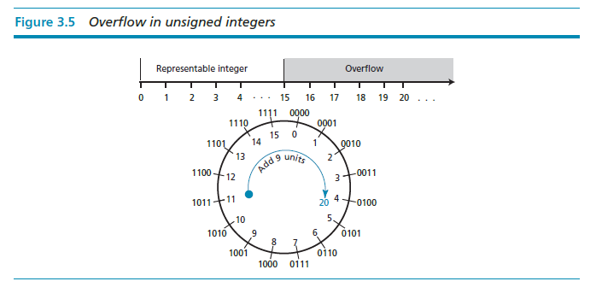
Figure 3.5 shows what happens if we try to store an integer that is larger than 2⁴ − 1 = 15 in a memory location that can only hold four bits.

Slide 17
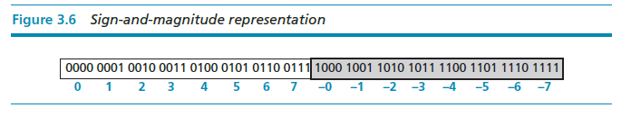
Sign-and-magnitude representation
In this method, the available range for unsigned integers (0 to 2^{n} − 1) is divided into two equal sub-ranges. The first half represents positive integers, the second half, negative integers.

Slide 18
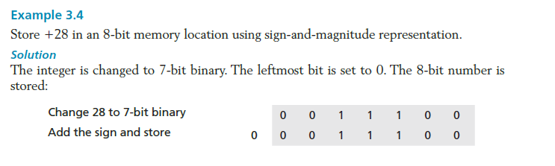

Slide 19
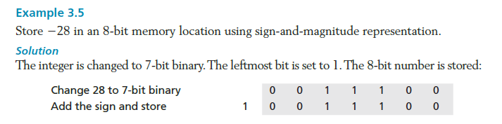

Slide 20
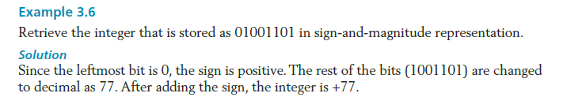

Slide 21
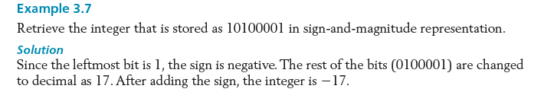

Slide 22
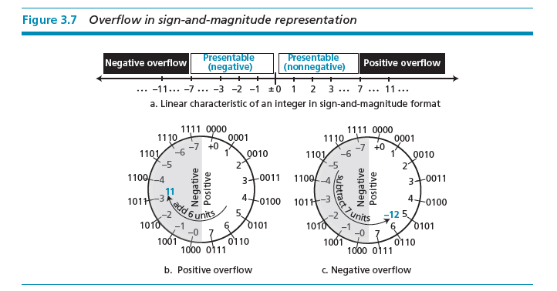
Figure 3.7 shows both positive and negative overflow when storing an integer in sign-and-magnitude representation using a 4-bit memory location.

Slide 23
Two’s complement representation
Almost all computers use two’s complement representation to store a signed integer in an n-bit memory location. In this method, the available range for an unsigned integer of (0 to 2n − 1) is divided into two equal sub-ranges. The first sub-range is used to represent nonnegative integers, the second half to represent negative integers. The bit patterns are then assigned to negative and nonnegative (zero and positive) integers as shown in Figure 3.8.

Slide 24
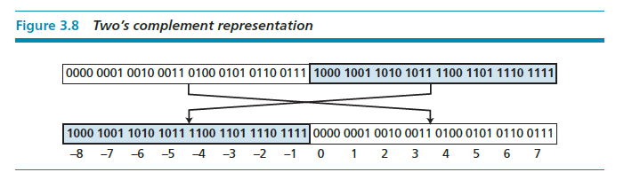


Slide 25
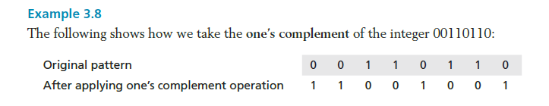
One’s Complementing
Before we discuss this representation further, we need to introduce two operations. The first is called one’s completing or taking the one’s complement of an integer. The operation can be applied to any integer, positive or negative. This operation simply reverses (flips) each bit. A 0-bit is changed to a 1-bit, a 1-bit is changed to a 0-bit.

Slide 26



Slide 27
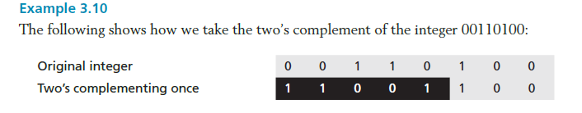
Two’s Complementing
The second operation is called two’s completing or taking the two’s complement of an integer in binary. This operation is done in two steps. First, we copy bits from the right until a 1 is copied; then, we flip the rest of the bits.

Slide 28
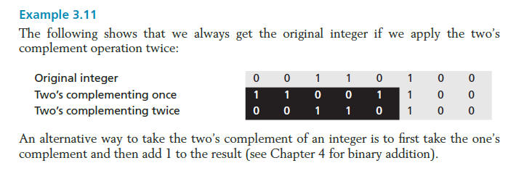

Slide 29
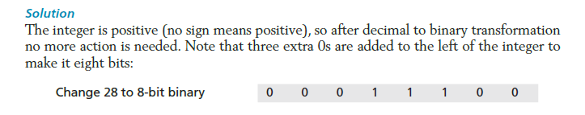

Slide 30
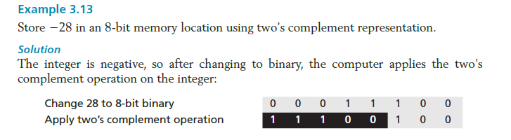

Slide 31
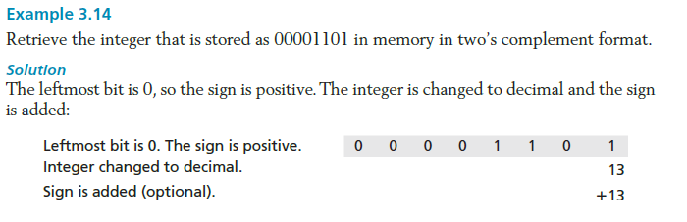

Slide 32
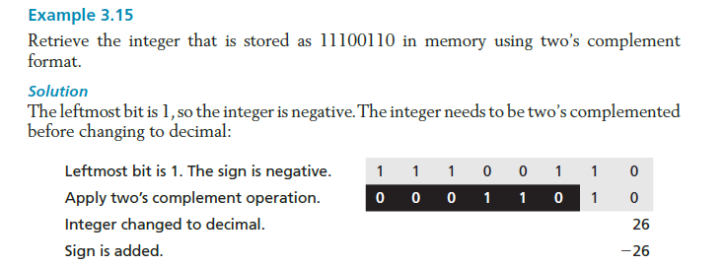

Slide 33
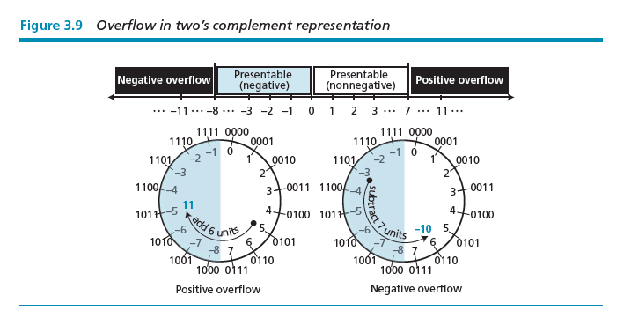

Slide 34
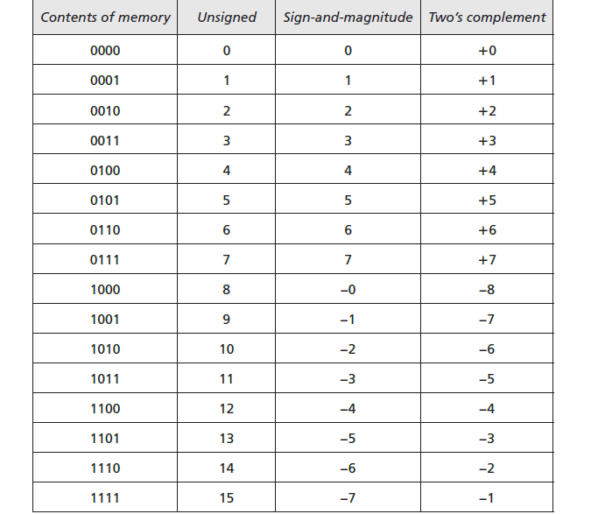
Comparison of the three systems

Slide 35

Storing reals
A real is a number with an integral part and a fractional part. For example, 23.7 is a real number—the integral part is 27 and the fractional part is 7/10. Although a fixed-point representation can be used to represent a real number, the result may not be accurate or it may not have the required precision. The next two examples explain why.

Slide 36
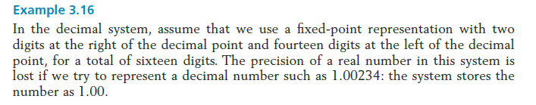
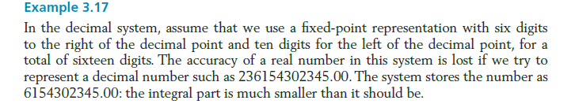

Slide 37
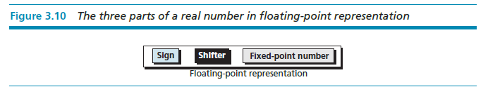
Floating-point representation
The solution for maintaining accuracy or precision is to used floating-point representation.

Slide 38
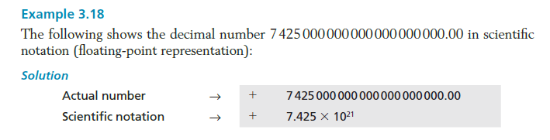

Slide 39
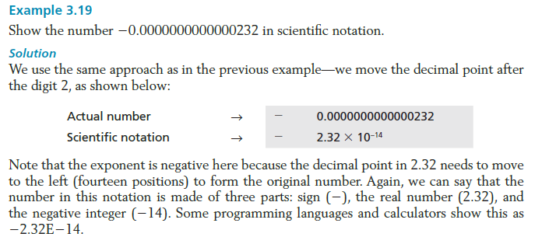

Slide 40
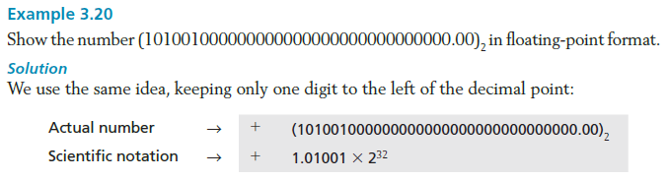

Slide 41
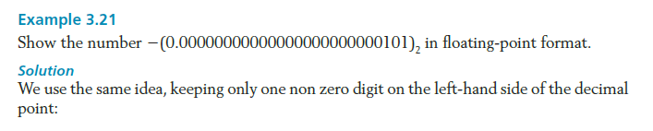

Slide 42
Normalization
To make the fixed part of the representation uniform, both the scientific method (for the decimal system) and the floating-point method (for the binary system) use only one non-zero digit on the left of the decimal point. This is called normalization. In the decimal system this digit can be 1 to 9, while in the binary system it can only be 1. In the following, d is a non-zero digit, x is a digit, and y is either 0 or 1.

Slide 43
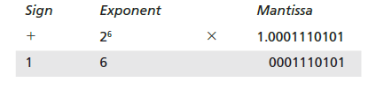



Slide 44
Excess System
The exponent, the power that shows how many bits the decimal point should be moved to the left or right, is a signed number. Although this could have been stored using two’s complement representation, a new representation, called the Excess system, is used instead. In the Excess system, both positive and negative integers are stored as unsigned integers. To represent a positive or negative integer, a positive integer (called a bias) is added to each number to shift them uniformly to the non-negative side. The value of this bias is 2^{m−1} − 1, where m is the size of the memory location to store the exponent.

Slide 45
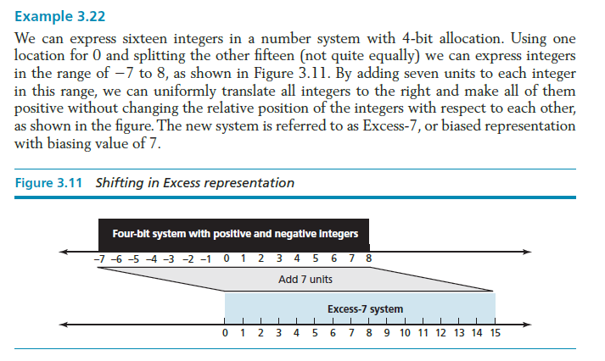

Slide 46
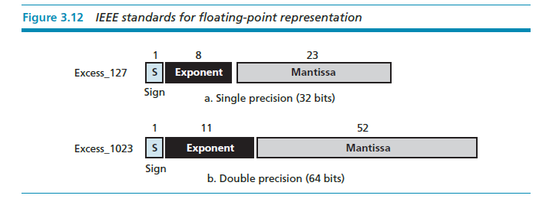
IEEE Standard

Slide 47
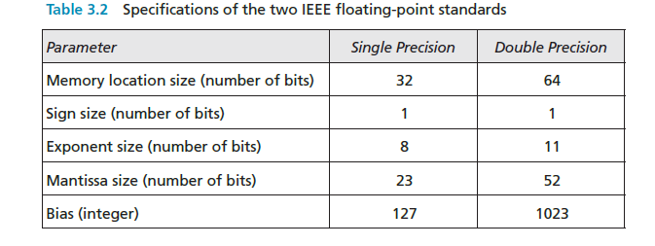
IEEE Specifications

Slide 48
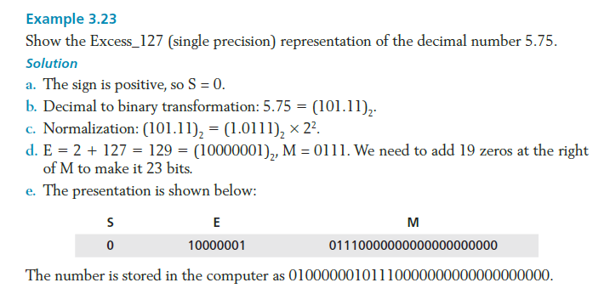

Slide 49
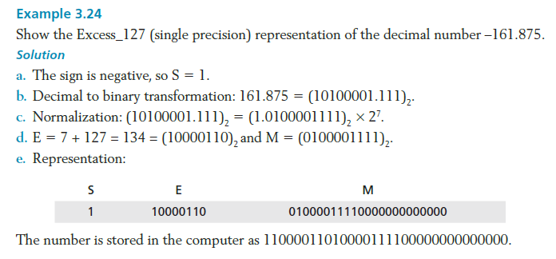

Slide 50
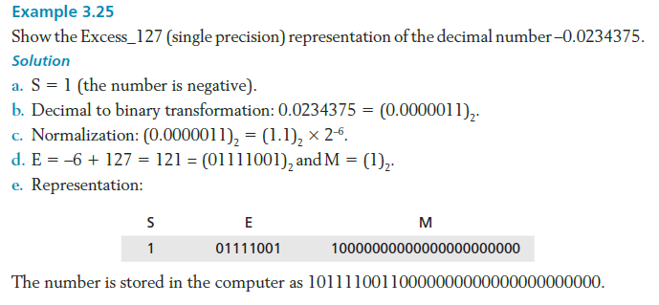

Slide 51
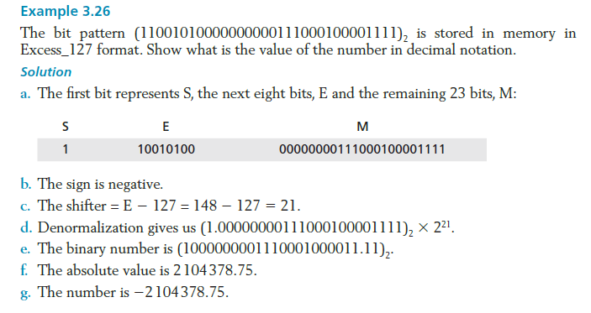

Slide 52
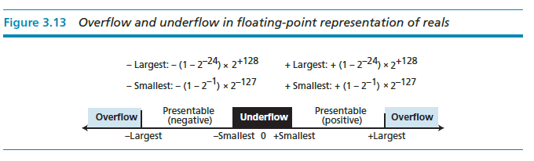
Overflow and Underflow
Storing Zero
A real number with an integral part and the fractional part set to zero, that is, 0.0, cannot be stored using the steps discussed above. To handle this special case, it is agreed that in this case the sign, exponent, and the mantissa are set to 0s.

Slide 53
STORING TEXT
A section of text in any language is a sequence of symbols used to represent an idea in that language. For example, the English language uses 26 symbols (A, B, C,…, Z) to represent uppercase letters, 26 symbols (a, b, c, …, z) to represent lowercase letters, nine symbols (0, 1, 2, …, 9) to represent numeric characters and symbols (., ?, :, ; , …, !) to represent punctuation. Other symbols such as blank, newline, and tab are used for text alignment and readability.

Slide 54
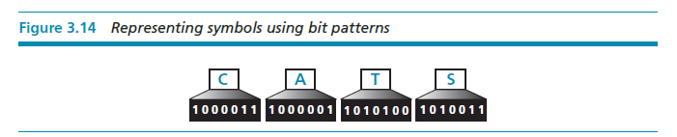
We can represent each symbol with a bit pattern. In other words, text such as “CATS”, which is made up from four symbols, can be represented as four n-bit patterns, each pattern defining a single symbol (Figure 3.14).

Slide 55
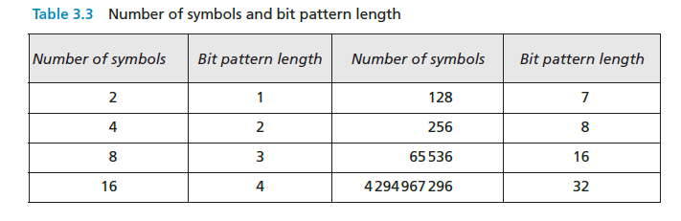

Slide 56
Codes
ASCII
Unicode
Other Codes
SEE APPENDIX A

Slide 57
STORING AUDIO
Audio is a representation of sound or music. Audio, by nature, is different than the numbers or text we have discussed so far. Text is composed of countable entities (characters): we can count the number of characters in text. Text is an example of digital data. In contrast, audio is not countable. Audio is an example of analog data. Even if we are able to measure all its values in a period of time, we cannot store these in the computer’s memory, as we would need infinite number of memory locations. Figure 3.15 shows the nature of an analog signal, such as audio, that varies with time.

Slide 58
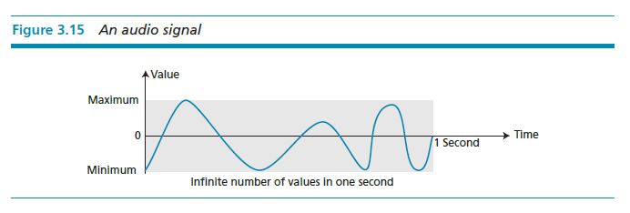

Slide 59
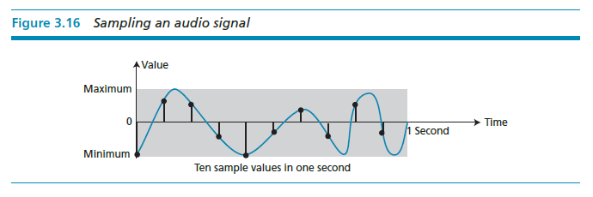
Sampling
If we cannot record all the values of a an audio signal over an interval, we can record some of them. Sampling means that we select only a finite number of points on the analog signal, measure their values, and record them.

Slide 60
Quantization
The value measured for each sample is a real number. This means that we can store 40,000 real values for each one second sample. However, it is simpler to use an unsigned integer (a bit pattern) for each sample. Quantization refers to a process that rounds the value of a sample to the closest integer value. For example, if the real value is 17.2, it can be rounded down to 17: if the value is 17.7, it can be rounded up to 18.

Slide 61
Encoding
The quantized sample values need to be encoded as bit patterns. Some systems assign positive and negative values to samples, some just shift the curve to the positive part and assign only positive values.
If we call the bit depth or number of bits per sample B, the number of samples per second, S, we need to store S × B bits for each second of audio. This product is sometimes refer to as bit rate, R. For example, if we use 40,000 samples per second and 16 bits per each sample, the bit rate is
R = 40,000 × 16 = 640,000 bits per second

Slide 62
Standards for sound encoding
Today the dominant standard for storing audio is MP3 (short for MPEG Layer 3). This standard is a modification of the MPEG (Motion Picture Experts Group) compression method used for video. It uses 44100 samples per second and 16 bits per sample. The result is a signal with a bit rate of 705,600 bits per second, which is compressed using a compression method that discard information that cannot be detected by the human ear. This is called lossy compression, as opposed to lossless compression: see Chapter 16.

Slide 63
STORING IMAGES
Images are stored in computers using two different techniques: raster graphics and vector graphics.
Raster graphics
Raster graphics (or bitmap graphics) is used when we need to store an analog image such as a photograph. A photograph consists of analog data, similarly to audio information: the difference is that the intensity (color) of data varies in space instead of in time. This means that data must be sampled. However, sampling in this case is normally called scanning. The samples are called pixels (picture elements).

Slide 64
Resolution
Just like audio sampling, in image scanning we need to decide how many pixels we need to record for each square or linear inch. The scanning rate in image processing is called resolution. If the resolution is sufficiently high, the human eye cannot recognize the discontinuity in reproduced images.
Color depth
The number of bits used to represent a pixel, its color depth, depends on how the pixel’s color is handled by different encoding techniques. The perception of color is how our eyes respond to a beam of light. Our eyes have different types of photoreceptor cells: some respond to the three primary colors red, green, and blue (often called RGB), while others merely respond to the intensity of light.

Slide 65
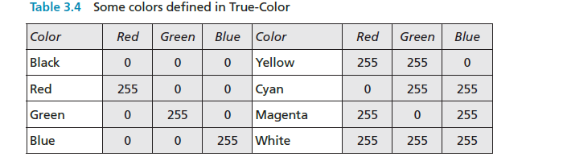
True-Color
One of the techniques used to encode a pixel is called True-Color, which uses 24 bits to encode a pixel.

Slide 66
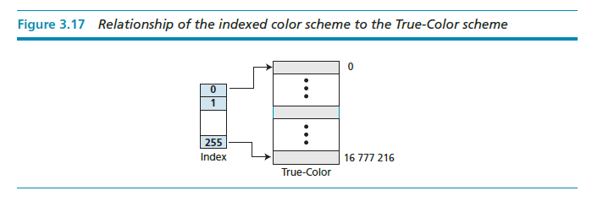
Indexed color
The indexed color—or palette color—scheme uses only a portion of these colors.

Slide 67

For example, a high-quality digital camera uses almost three million pixels for a 3 × 5 inch photo. The following shows the number of bits that need to be stored using each scheme:

Slide 68
Standards for image encoding
Several de facto standards for image encoding are in use. JPEG (Joint Photographic Experts Group) uses the True-Color scheme, but compresses the image to reduce the number of bits (see Chapter 15). GIF (Graphic Interchange Format), on the other hand, uses the indexed color scheme.

Slide 69
Vector graphics
Raster graphics has two disadvantages: the file size is big and rescaling is troublesome. To enlarge a raster graphics image means enlarging the pixels., so the image looks ragged when it is enlarged. The vector graphic image encoding method, however, does not store the bit patterns for each pixel. An image is decomposed into a combination of geometrical shapes such as lines, squares, or circles.
For example, consider a circle of radius r. The main pieces of information a program needs to draw this circle are:
The radius r and equation of a circle.
The location of the center point of the circle.
The stroke line style and color.
The fill style and color.

Slide 70
STORING VIDEO
Video is a representation of images (called frames) over time. A movie consists of a series of frames shown one after another. In other words, video is the representation of information that changes in space and in time. So, if we know how to store an image inside a computer, we also know how to store video: each image or frame is transformed into a set of bit patterns and stored. The combination of the images then represents the video.
SEE CHAPTER 16 FOR VIDEO COMPRESSION

