Slide 1
Chapter 2
Number Systems

Slide 2
Objectives
After studying this chapter, the student should be able to:
Understand the concept of number systems.
Distinguish between non-positional and positional number systems.
Describe the decimal, binary, hexadecimal, and octal system.
Convert a number in binary, octal, or hexadecimal to a number in the decimal system.
Convert a number in the decimal system to a number in binary, octal, and hexadecimal.
Convert a number in binary to octal and vice versa.
Convert a number in binary to hexadecimal and vice versa.
Find the number of digits needed in each system to represent a particular value.

Slide 3
INTRODUCTION
A number system defines how a number can be represented using distinct symbols. A number can be represented differently in different systems. For example, the two numbers (2A)₁₆ and (52)₈ both refer to the same quantity, (42)₁₀, but their representations are different.
Several number systems have been used in the past and can be categorized into two groups: positional and non-positional systems. Our main goal is to discuss the positional number systems, but we also give examples of non-positional systems.

Slide 4
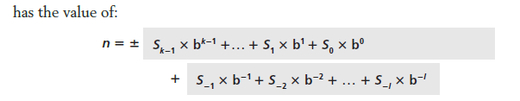
POSITIONAL NUMBER SYSTEMS
In a positional number system, the position a symbol occupies in the number determines the value it represents. In this system, a number represented as:
in which S is the set of symbols, b is the base (or radix).

Slide 5
The decimal system (base 10)
The word decimal is derived from the Latin root decem (ten). In this system the base b = 10 and we use ten symbols
S = {0, 1, 2, 3, 4, 5, 6, 7, 8, 9}
The symbols in this system are often referred to as decimal digits or just digits.

Slide 6
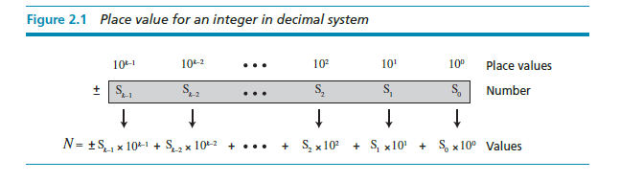
Integers

Slide 7
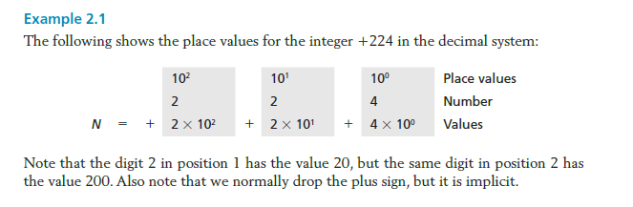

Slide 8
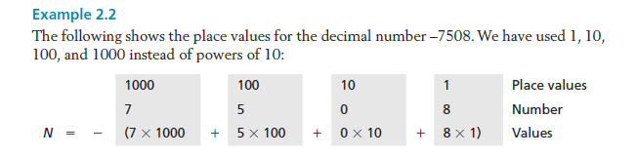

Slide 9
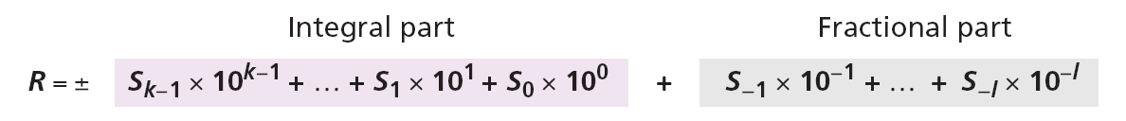
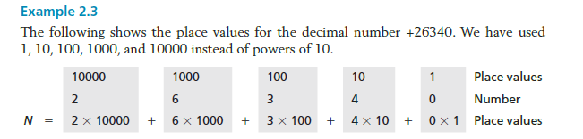
Reals
A real (a number with a fractional part) in the decimal system is also familiar. For example, we use this system to show dollars and cents ($23.40). We can represent a real as

Slide 10
The binary system (base 2)
The word binary is derived from the Latin root bini (or two by two). In this system the base b = 2 and we use only two symbols, S = {1, 2}. The symbols in this system are often referred to as binary digits or bits (binary digit).

Slide 11
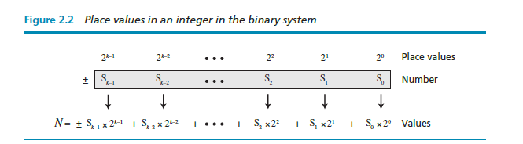
Integers
We can represent an integer as:

Slide 12
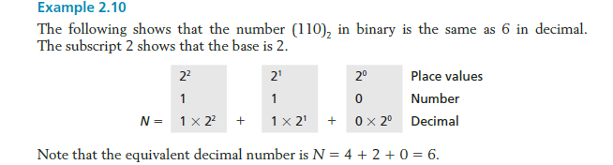

Slide 13
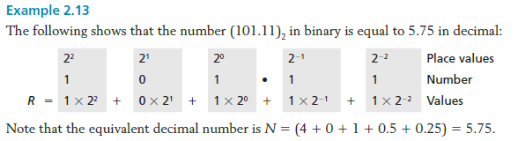
Reals
A real—a number with an optional fractional part—in the binary system can be made of K bits on the left and L bits on the right:

Slide 14
The hexadecimal system (base 16)
The word hexadecimal is derived from the Greek root hex (six) and the Latin root decem (ten). In this system the base b = 16 and we use sixteen symbols to represent a number. The set of symbols is
S = {0, 1, 2, 3, 4, 5, 6, 7, 8, 9, A, B, C, D, E, F}
Note that the symbols A, B, C, D, E, F are equivalent to 10, 11, 12, 13, 14, and 15 respectively. The symbols in this system are often referred to as hexadecimal digits.

Slide 15
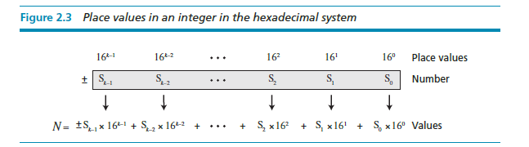
Integers
We can represent an integer as:

Slide 16
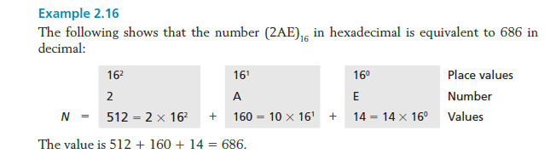

Slide 17
The octal system (base 8)
The word octal is derived from the Latin root octo (eight). In this system the base b = 8 and we use eight symbols to represent a number. The set of symbols is

Slide 18
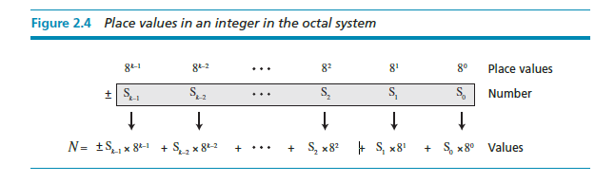
Integers
We can represent an integer as:

Slide 19
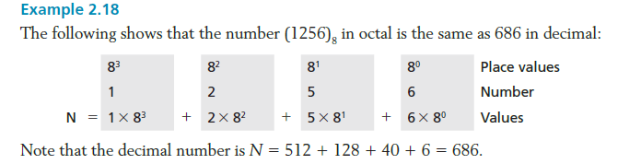

Slide 20
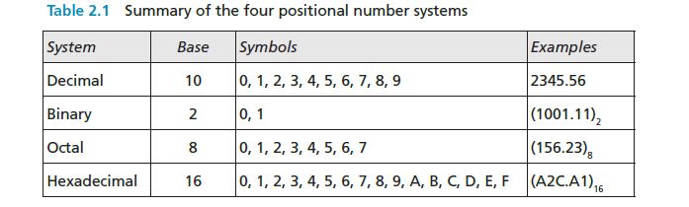
Summary of the four positional systems
Table 2.1 shows a summary of the four positional number systems discussed in this chapter.

Slide 21
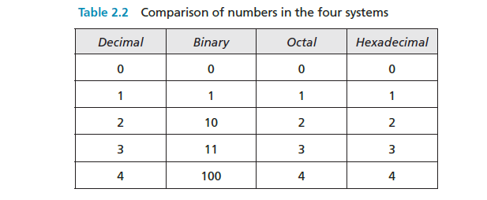
Table 2.2 shows how the number 0 to 15 is represented in different systems.

Slide 22
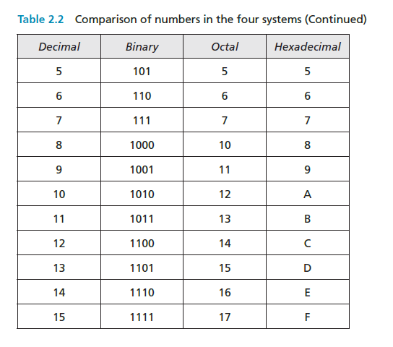

Slide 23
Conversion
We need to know how to convert a number in one system to the equivalent number in another system. Since the decimal system is more familiar than the other systems, we first show how to covert from any base to decimal. Then we show how to convert from decimal to any base. Finally, we show how we can easily convert from binary to hexadecimal or octal and vice versa.

Slide 24
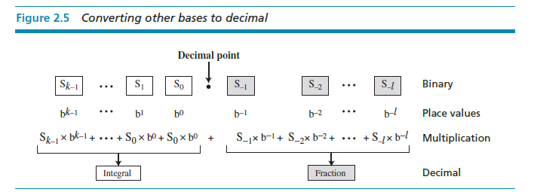
Any base to decimal conversion

Slide 25
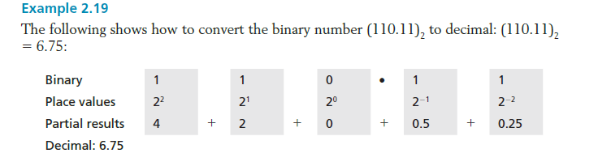

Slide 26
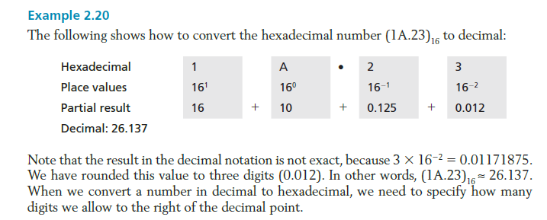

Slide 27
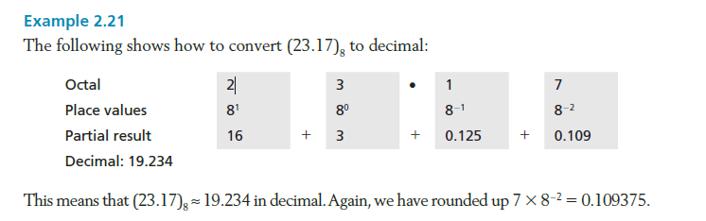

Slide 28
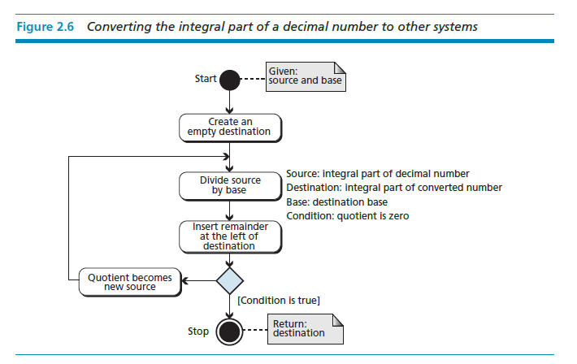
Decimal to any base

Slide 29
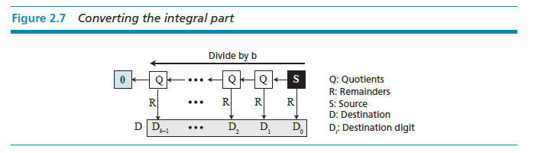

Slide 30
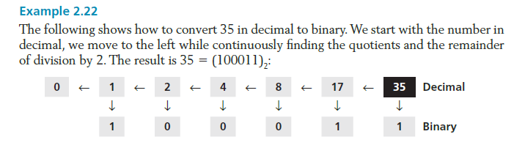

Slide 31
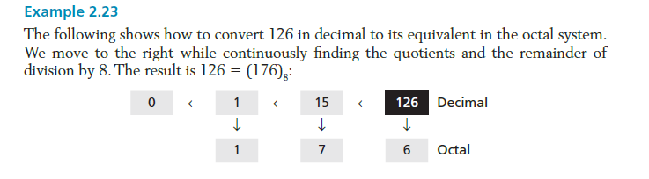

Slide 32
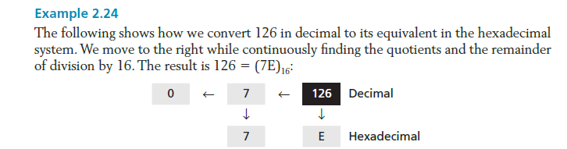

Slide 33
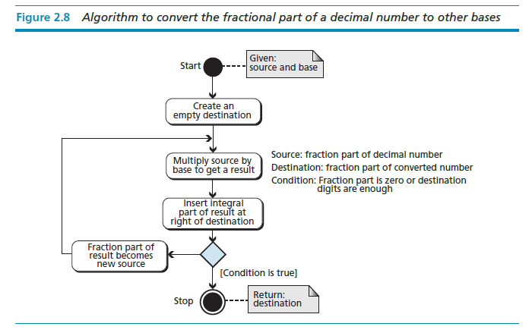

Slide 34
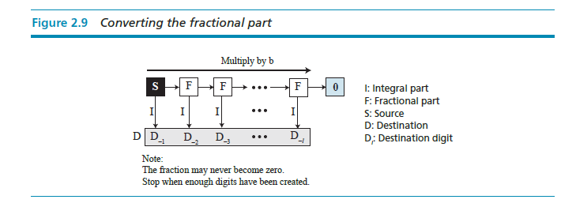

Slide 35
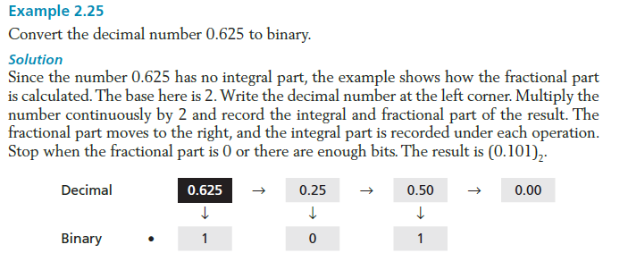

Slide 36
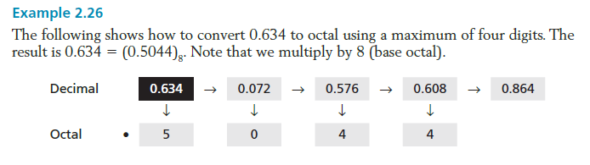

Slide 37
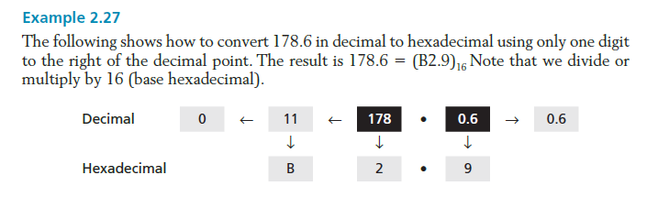

Slide 38
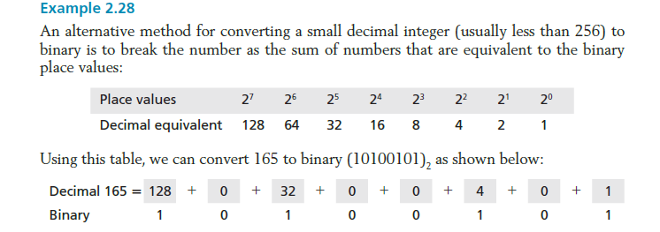

Slide 39
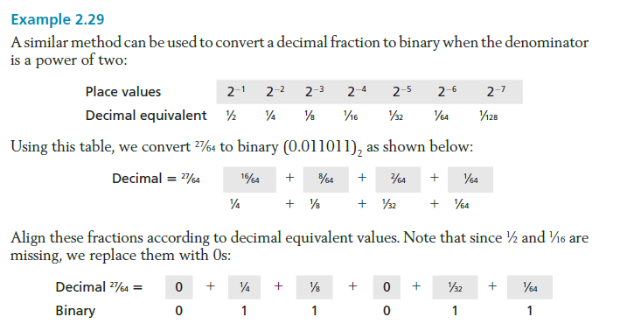

Slide 40
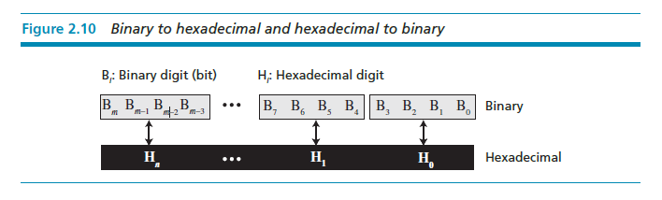
Binary-hexadecimal conversion

Slide 41
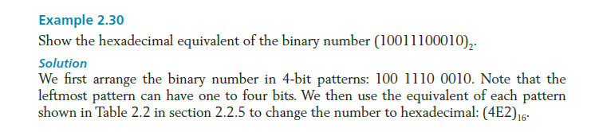

Slide 42
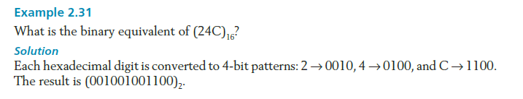

Slide 43
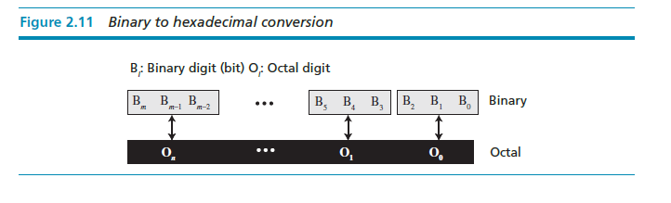
Binary-octal conversion

Slide 44
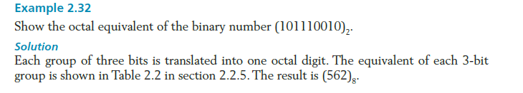

Slide 45
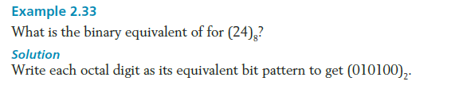

Slide 46
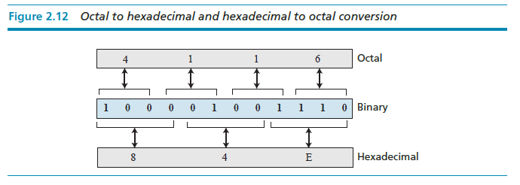
Octal-hexadecimal conversion

Slide 47
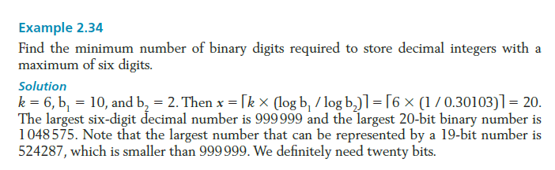

Slide 48
NONPOSITIONAL NUMBER SYSTEMS
Although non-positional number systems are not used in computers, we give a short review here for comparison with positional number systems. A non-positional number system still uses a limited number of symbols in which each symbol has a value. However, the position a symbol occupies in the number normally bears no relation to its value—the value of each symbol is fixed. To find the value of a number, we add the value of all symbols present in the representation.

Slide 49

In this system, a number is represented as:
and has the value of:
There are some exception to the addition rule we just mentioned, as shown in Example 2.35.

Slide 50
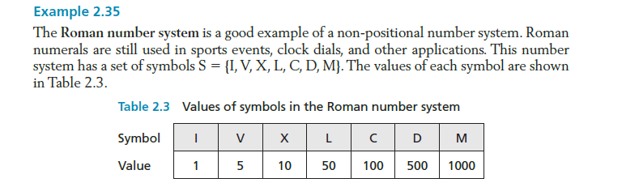

Slide 51
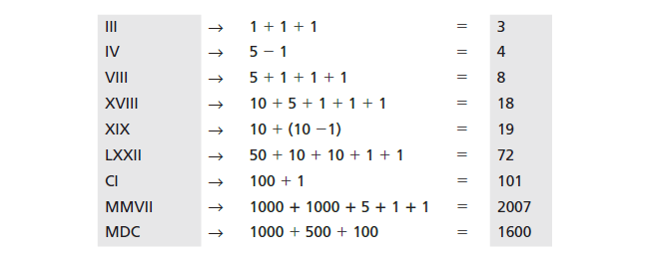
The following shows some Roman numbers and their values.

